Slide 1

Ai’tmad Departmental Plan
2014-2015

Slide 2
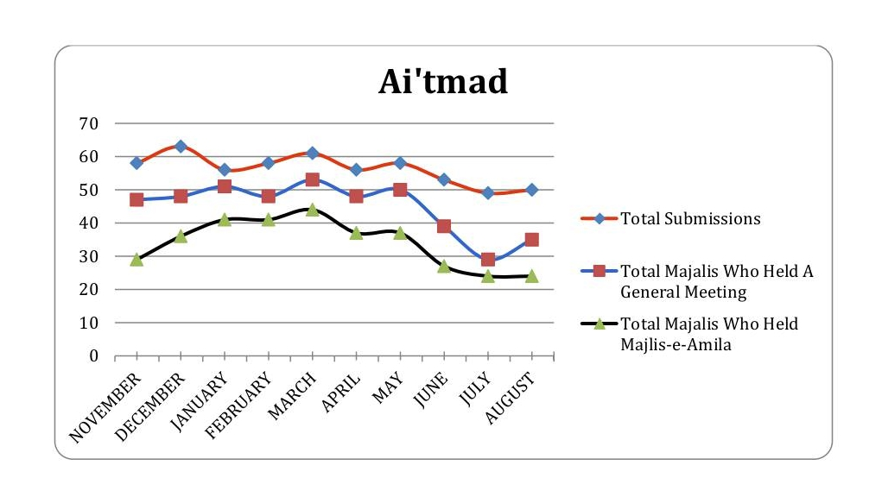
Monthly Goals
Hold monthly General and Amila meetings
Submit monthly report on time
Notes:
Qaid is sometimes burdened with a lot of work. Off load work to Motamid (create agenda, set up meetings)
We will try to send them a sample agenda each month
Every majalis is required to submit a report, regardless if there has been activity or not. It is better to submit a blank report than not reporting at all. All of this information is consolidated and sent to Huzur every month.
Aitmad department will email out a reporting link every month.

Slide 3
Successes/Challenges
Challenges:
  Communication to local Qaideen/Nazimeen
  Reporting feedback
Successes:
  Telegram
  @mkausa.org accounts
Notes:
The biggest challenge the Aitmad department faces today is communicating to local Qaideen and Nazimeen. To make communication easy, the Qaid should:
Set up mkausa email address (main avenue of communication)
Submit local amila (so we are not bombarding qaideen with emails/muhtaimimeen will contact nazimeen)
Set up telegram and join the appropriate group chats
Submitting local Amila is important so the Muhtaimimeen can directly be in contact with local Nazimeen so the Qaid is not overwhelmed with emails.

