Slide 1

Sanat-o-Tijarat
Department Plans 2014-15
Intisar Malhi

Slide 2
How does this fit in?
NOT asking for
Financial Sacrifice
Distribute Flyers
Sacrifice your Family
Blood Donation
Sacrifice your Time
Highway Cleanup
Cook Food for Meeting
We do not ask Khuddam to serve – We Serve the Khuddam

Slide 3
How can we help?
Job Search Assistance
Resumes, Cover Letters, Job Applications, etc
Mentoring – students, professionals, etc
Skills to build your professional career
Help grow your business
Help students in career choices

Slide 4
Goals
Monthly Newsletter
Share Job Opportunities
Job Candidates
Online Professional Directory

Slide 5
Monthly Newsletter
Main communication platform
Share resources available to learn various hard skills to excel in specific areas
Build Soft Skills necessary for success in general
Share Job opportunities
Share Job candidates profiles anonymously
Share article about career development and entrepreneurship

Slide 6
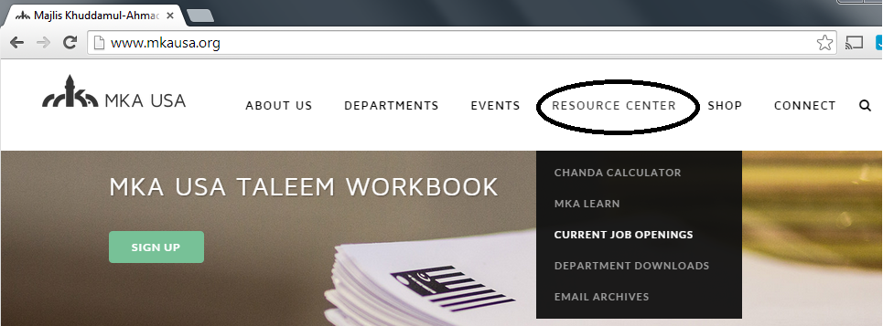
Share Job Opportunities
Jobs come with a referral
Emailed to Qaideen/Nazimeen

Slide 7
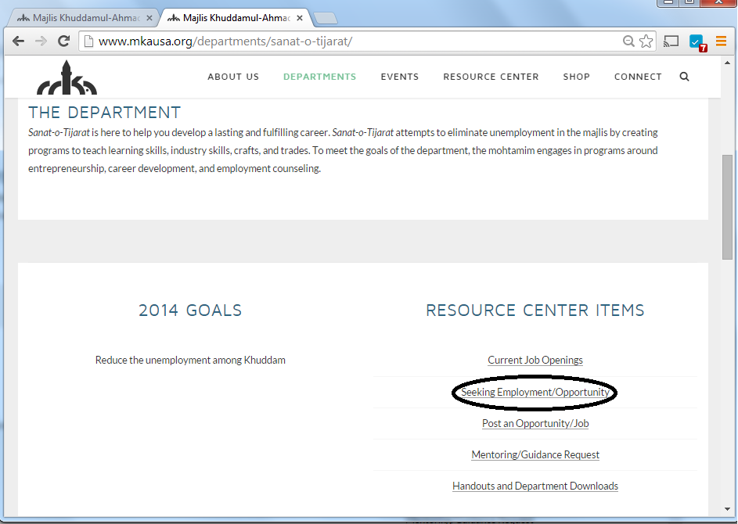
Job Candidates

Slide 8
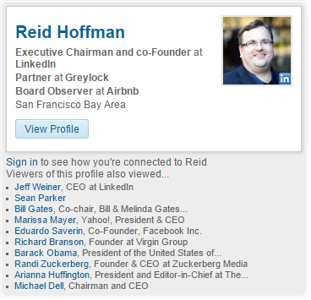
Online Professional Directory
Ahmadiyya Resource Directory for the online networking age
Add value to your professional network with the help of Majlis Khuddam ul Ahmadiyya
Build on the LinkedIn platform

Slide 9
Career Profiles - Pilot
Video Profiles
Khuddam from various career backgrounds
Showcase the diversity of resources in Majlis Khuddam ul Ahmadiyya
Inspire our youth – present options

Slide 10
The Team
Intisar Malhi
Mohtamim
intisar.malhi@mkausa.org
925-451-2442
Faiq Malik
Naib Mohtamim
faiq.malik@mkausa.org
703-389-3388
Tariq Bhatti
Naib Mohtamim
tariq.bhatti@mkausa.org
713-670-4841
sanatotijarat@mkausa.org
http://www.mkausa.org/departments/sanat-o-tijarat/

