Slide 1

Tehrik-e-Jadid
Department Plan Overview
2014-2015

Slide 2
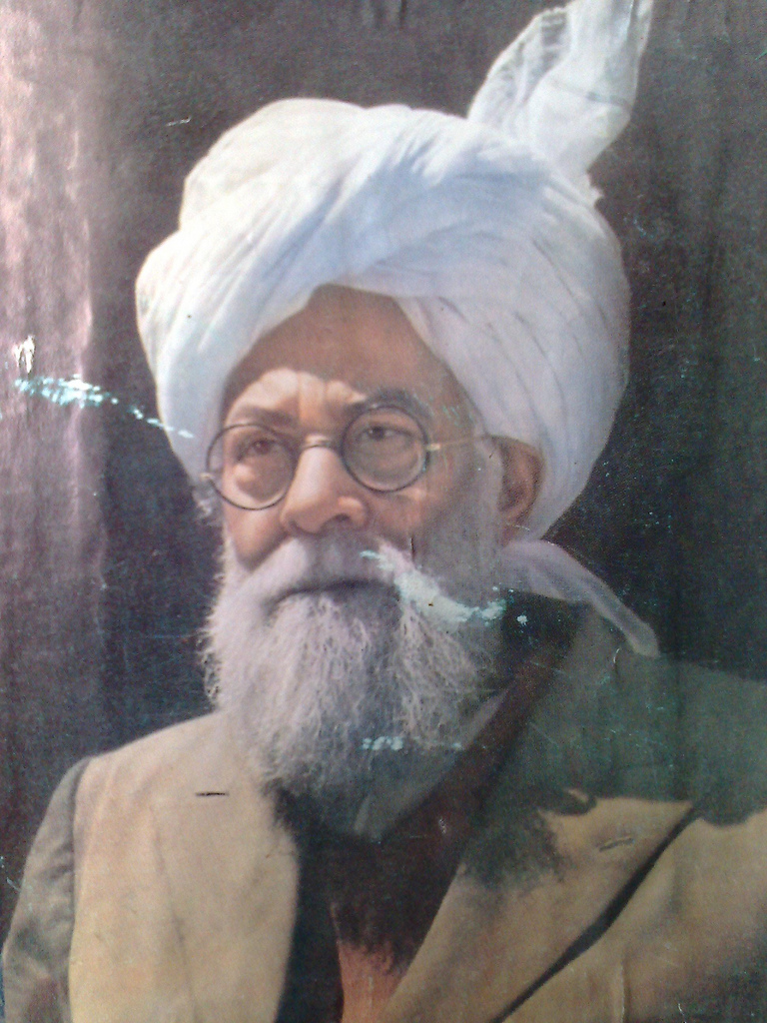
THE PURPOSE
“This is not my scheme, rather it is a scheme revealed by God…The purpose of initiating Tehrik e Jadid is to generate necessary funds for the propagation of the name of God to the corners of the world. It is initiated so that individuals could devote their entire lives for the propagation of Islam. Tehrik e Jadid is initiated so that the members of our Jama’at would gain that courage and perseverance that should be a characteristic of active and efficient organizations.”
Hadhrat Khalifatul Masih II
Friday Sermon, November 27, 1942

Slide 3
THE PLAN (GOALS/DATES)
Goals:
1) Increase participation/collection (National goal is 100% participation from all Jama’at members)
2) Increase awareness amongst Khuddam of TJ, history, impact
Key Dates:
* 11/1/2014 – Start of TJ Year
* 6/18/2015 – Ramadan starts (tentative), TJ drive begins
* 10/1/2015 – Last month to collect, TJ year-end drive begins

Slide 4
THE PLAN (FROM US)
Deliverables:
* Continuation of monthly newsletter w/more content
* Continue Food for Soul and collect “snacks for soul”
* Continue getting data from Markaz
* Maintain and expand Jama’at TJ Twitter account (@TehrikeJadid)
* Develop special Waqf-e-Ardhi project w/Jama’at dept for Khuddam
* Continue calls every quarter and visit every region at least once
* Hold contest at Ijtema
* Explore creation of more digital media (i.e. videos)

Slide 5
THE PITCH (TO YOU)
* Have Nazim develop relationship with Jama’at TJ Secretary and/or Jama’at Finance secretary
* Have Nazim approach/call all Khuddam and Atfal for pledges now, later in year have them approach/call for collection and check w/Jama’at secretaries to see if they actually did participate later on (by default you and Nazim are not collecting, up to Jama’at secretaries if they want you to).
* Forward content we send you to all Khuddam/Atfal
* Reg. Qaideen – work with us to set up a good time for us to visit in the year and have a Regional MKA TJ Day. We will webex those that are far away
* When we send details on Snacks for the Soul (personal stories of financial sacrifice from Khuddam/Atfal)
and Waqfe-Ardhi project, get Majlis excited about these initiatives.
* RETURN OUR CALLS AND EMAILS!

Slide 6
THE PEOPLE
Mohtamim Tehrik-e-Jadid - Zarik Khan - 630-309-2640 – zarik.khan@mkausa.org
Naib Mohtamim Tehrik-e-Jadid – Asim Malik – 261-371-9359 – ama.malik@gmail.com
Naib Mohtamim Tehrik-e-Jadid – Salam Khan – 951-275-7687 – salamkhan92@gmail.com
Naib Mohtamim Tehrik-e-Jadid – Danisch Malik – 571-239-7067 – dmalik3@gmail.com
Naib Mohtamim Tehrik-e-Jadid – Atiq Chaudhry – 646-739-9526 – chatiq7@gmail.com

