Slide 1


The Purpose of
Majlis Khuddam-ul-Ahmadiyya:
Fadl-e-Umar Quotes

Slide 2
Reformation of Youth
“I have repeatedly brought to the attention of the whole Jama’at this point, that the reformation of nations cannot take place until the reformation of the youth. Unless future generations hold in highest regard this faith and its principles, which are established on earth by Allah through his prophets and appointed ones, until that time, further progress can never be made in this regard.”
-Hazrat Khalifatul Masih II RA

Slide 3
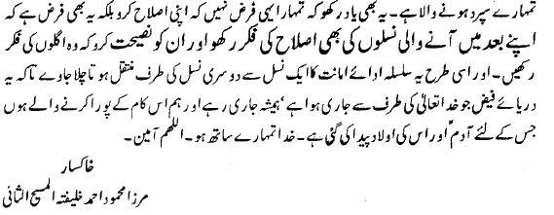
Training of Future Generations
Remember that your responsibility is not only to reform yourself but also to worry about the reformation of the generation after you, and to admonish them to worry about their future generations. And thus this system of fulfilling one’s trust should transfer from one generation to the next so that this river of God’s bounty may always continue to flow, and so that may we become those who fulfill the task for which Adam and his offspring were created. May God be with you. Ameen.

Slide 4
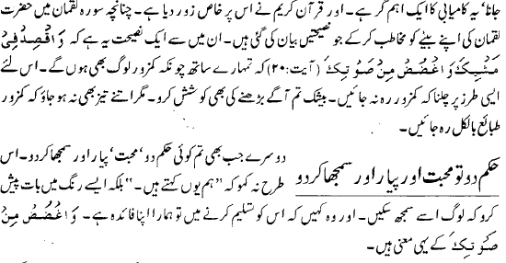
Qualities of Khuddam Leadership
In Surah Luqman, Hadrat Luqman has given various advices to his son. One of those advices is that “Be moderate in your walk, and keep your voice low.” That since there are weak people with you that’s why you should walk at a speed which does not leave the weak ones behind. You should definitely try to progress but not so fast that it separates you completely from the weak ones. Secondly, whenever you give an order do so with love, affection, and with explanation. Don’t say “I am ordering you”, instead present it in such a manner that people may understand. And they should say that it is in our favor to accept this commandment.

Slide 5
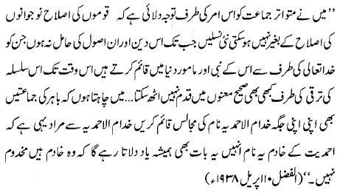
Servants of Islam-Ahmadiyyat
I have repeatedly drawn the attention of the Jama'at towards the point that the reformation of any nation cannot be accomplished without reforming their youth. Our organization cannot progress in the real sense until the new generations have upheld those principles of Islam that the Messengers of Allah had established in the world... Khuddam-ul-Ahmadiyya means the 'servants of Ahmadiyyat'. This name will always keep them reminded that they are servants, and not to be served.You must exhibit your own conduct in the best of manners. If you become a role model for the youth it would be impossible for them to resist joining your organization."

Slide 6
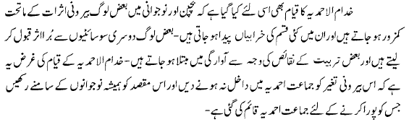
To Protect from Outside Influences
Khuddamul Ahmadiyya was established because in childhood and youth, some people become weak because of outside influences, and many evils take root [because of such influence]. Some people take bad influences from other societies and some become tied in vain pursuits due to certain spiritual weaknesses. The purpose of Khuddamul Ahmadiyya is to not allow such outside influences into Jama’at Ahmadiyya, and to always keep the purpose of the establishment of Jama’at Ahmadiyya in the forefront of the hearts and minds of the youth.

Slide 7
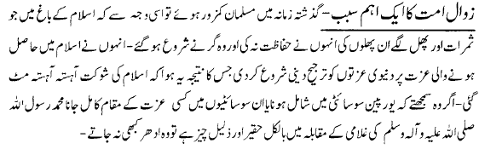
Outside Influences … continued
In previous eras, Muslims became weak because they did not protect the fruits which flourished in the garden of Islam, and hence they began to fall. They started giving importance to worldly honor over the honor which they received through Islam, the result of which was that glory of Islam slowly diminished. If they had realized that being part of the European society, or gaining some honor in these societies is abject and disdainful in comparison to the slavery of the Holy Prophet Muhammad (sa) then they would’ve never turned towards the world.

Slide 8
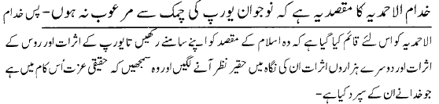
Outside Influences … continued
So, Khuddamul Ahmadiyya has been established so that they may always keep the purpose of Islam in front of them so that the effects of Europe and effects of Russia and thousands of other such effects may appear mean and disdainful to them, and so that they may realize that the true honor and dignity lies in doing the work which has been tasked to them by God.

Slide 9
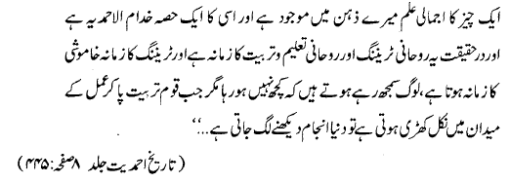
Training and Obedience
I have an overall view of the things in my mind and one part of that is Khuddam-ul-Ahmadiyya. This is a spiritual training and spiritual education... today is the time for the training of young men. The period of training is a silent period. People assume that nothing is happening, but when after receiving training the nation steps into the field of action, then the world sees the results.
In reality, a living nation that rises with the raising of the hand and sits down when the hand is lowered can make a great change in the world."

Slide 10
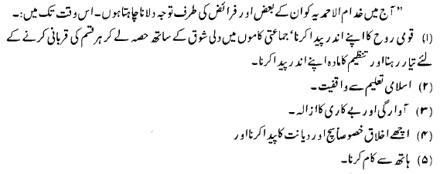
9 Characteristics of a Khadim
Establishment of Communal Pride, taking part in Jama’at activities with zeal and being ready to sacrifice everything, and creating unity and discipline.
Knowledge of Islamic Teachings
Getting rid of uselessness and vain habits
Inculcating good manners especially Truthfulness and Honesty
Working with your own hands

Slide 11

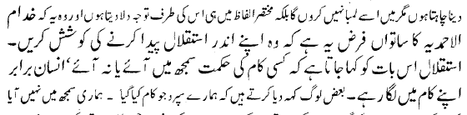

9 Characteristics of a Khadim
6) Our youth should be intelligent and they should have a grand and broad vision.
7) Steadfastness and Perseverance – whether one understands the wisdom behind a decision or not, he must continue to do his job.
8) Physical Fitness
9) Dissemination of Knowledge

Slide 12
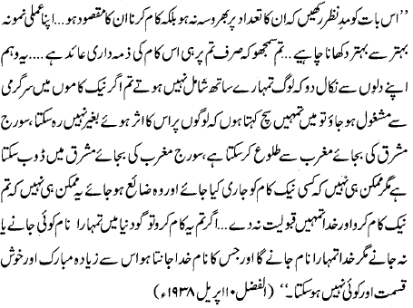
Glad-tiding to Khuddam
This should be remembered that they [Khuddam] should not rely on numbers but their real goal should be to work… their personal example should become better and better… you should think that the responsibility of this job is on you and you alone… Get this thought out of your mind that people are not joining you. If you were to immerse yourself in good deeds with passion then I tell you truly that it is impossible that it will not affect people. The sun can rise from the west instead of the east; it can set in the east instead of the west, but it is impossible that you start a good deed and it goes to waste.
It is impossible that you do good and God does not bestow you with acceptance… When you are steadfast on the Truth. When you maintain regularity in Prayers. When you are occupied day and night in the Service of Faith. Then know that your footsteps are at a level beyond which no doubt exists.
If you do these things, then it matters not whether people know you name or not, for God will know you and he who God knows is a most blessed and lucky one.

