Slide 1

Tajneed (Census)
Department Plans 2016-17
Majlis Khuddam-ul-Ahmadiyya
USA

Slide 2
Constitution
Muhtamim Tajneed shall keep the record of all members of Majlis and their necessary particulars
He shall strive to establish new Majalis

Slide 3
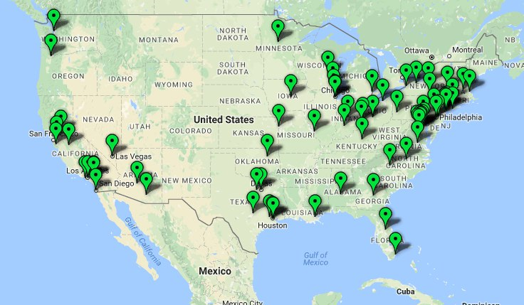
Overview
MKA USA maintains record of all Khuddam and Atfal in “Al-hisaab”, an in-house web application used for maal (finance) and tajneed.
This year we will use Jama’at Tajneed data as the baseline for reconciliation of the records in al-hisaab.
Total Chapters in MKA USA: 73

Slide 4
2016-2017 Goals
Maintain the most accurate information of all Khuddam and Atfal
Reconcile and analyze data that can be distributed to other departments and for internal planning. Examples include students’ data for Amoor-e-tulba (Student affairs), employment data to Sanat-o-tijarat (trade & commerce)
Strive to establish new chapters in the majlis

Slide 5
Tajneed Update Process
Each Local Qaid and Nazim Tajneed is requested to have a mandatory tajneed review every month
  Qaid majlis or Nazim tajneed to reconcile jamaat tajneed data and data currently maintained in al-hisaab
  Nazim Tajneed is to make all updates in al-hisaab and send any updates to be made in jamaat tajneed to MKA National Tajneed team via established google form

Slide 6
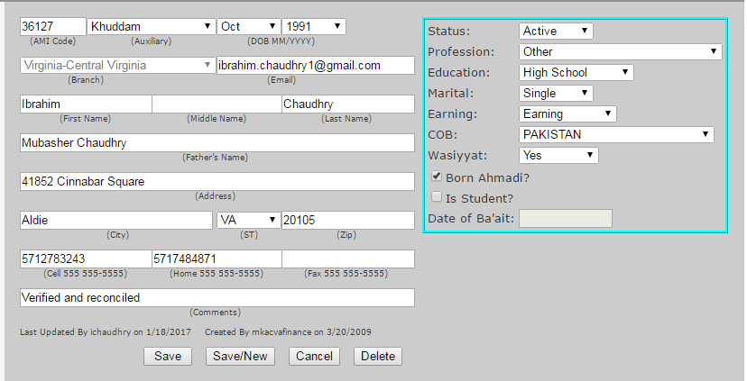
Sample member (Al-hisaab)

Slide 7
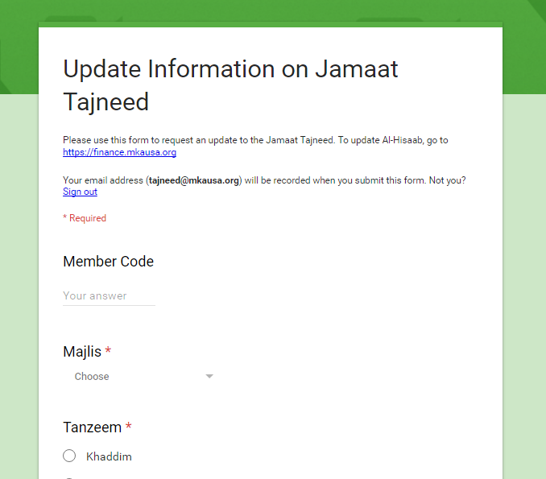
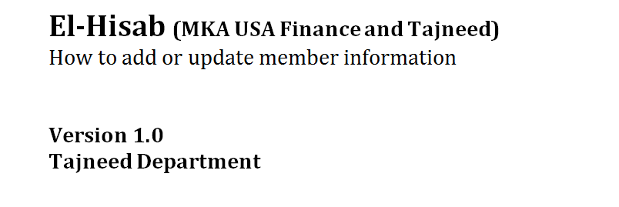
Resources
Guide
Form to submit updates to Jama’at Tajneed
To be posted at http://www.mkausa.org/departments/tajneed/
https://goo.gl/b6pfks

Slide 8
National Tajneed Team
Serving as Muhtamim Tajneed: Ibrahim Chaudhry (email: tajneed@mkausa.org, Cell: 571-278-3243)
Naib Muhtamim: Noman Ahmad (email: noman.ahmad@mkausa.org, Cell: 516-806-4214)
Naib Muhtamim: Saadat Malik (email: saadat.malik@mkausa.org, Cell: 703-343-3554)
Naib Muhtamim: Mumtaz Malik (email: mumtaz.malik@mkausa.org, Cell: 703-389-3310)

