Slide 1
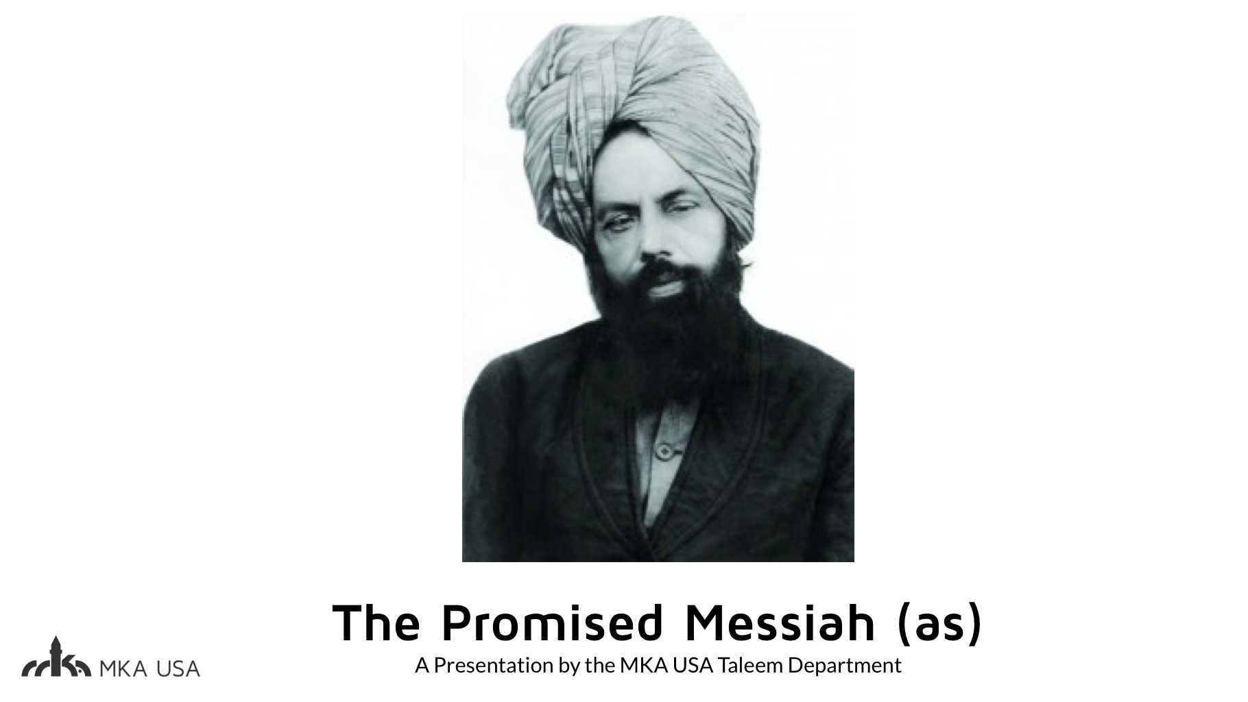

Slide 2
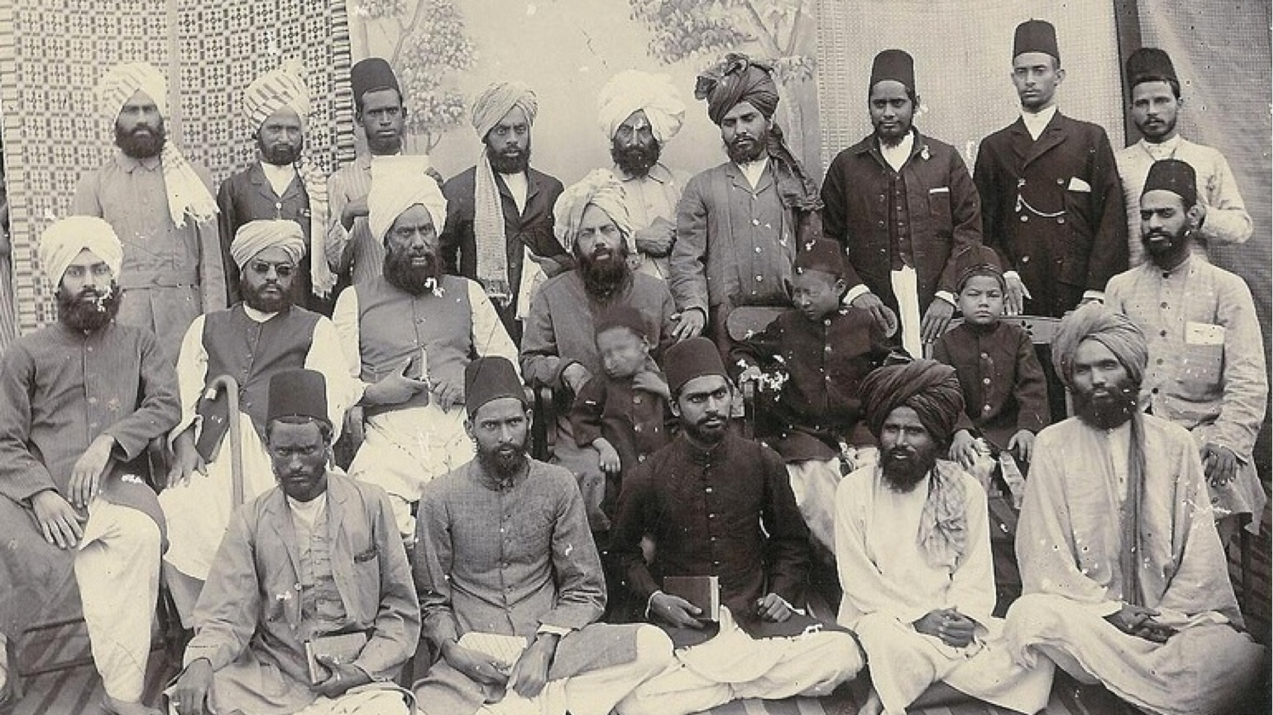

Slide 3
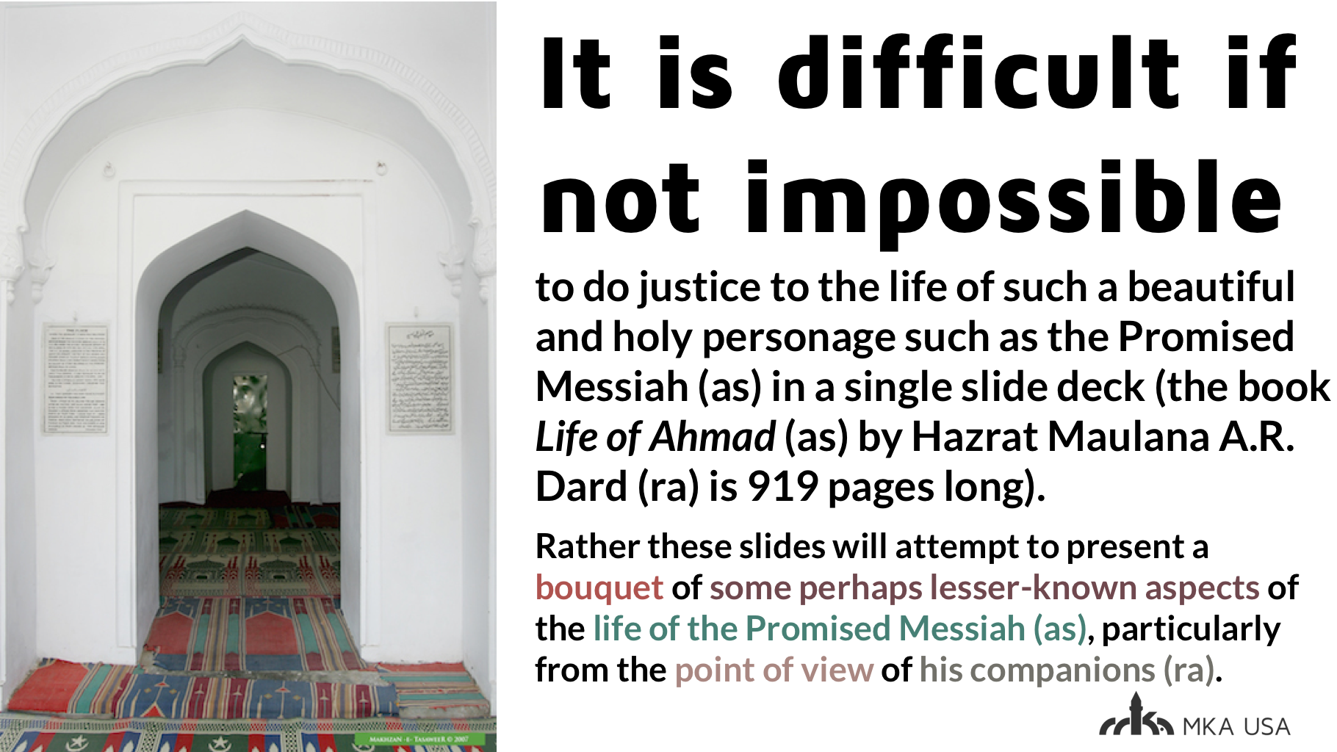

Slide 4
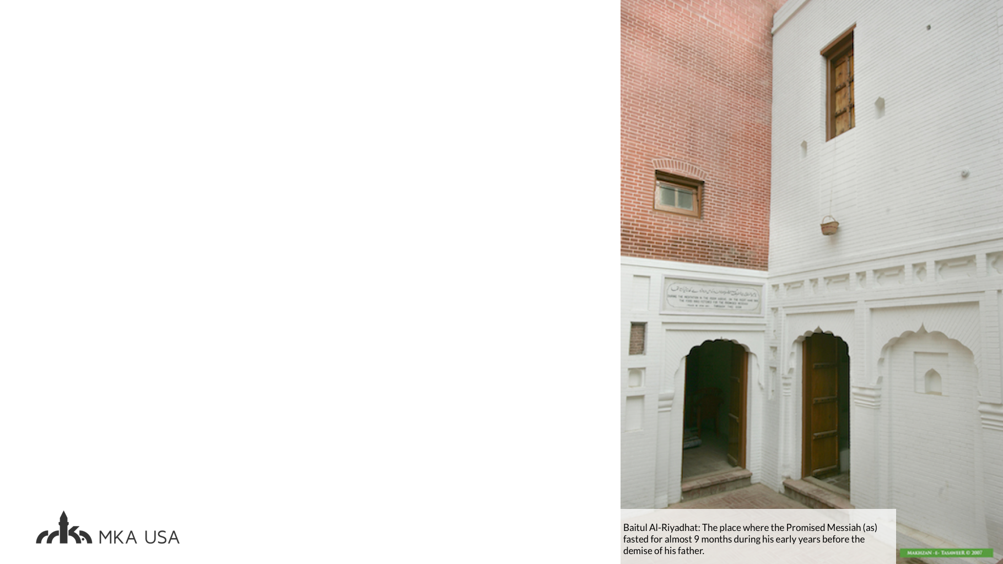
Hazrat Munshi Arure Khan (ra) of Kapurthala was asked by Mr. H. A. Waiter, Secretary of The Young Men's Christian Association, 'How long were you in contact with Mirza Sahib, what proof of his truth appealed to you most and what feature of his character impressed you more than others?'
To this Hazrat Munshi sb replied, “I knew Mirza Sahib even before he claimed to be the Messiah. I have never seen such a holy and luminous countenance. For me his luminous appearance and magnetic personality constituted the greatest proof of his truth. We were always eager to see his radiant face.” Recalling this, Hazrat Munshi sb began to sob.
Mr. Waiter was very much affected by this incident. He later wrote, “We may call Mirza Sahib deluded (God Forbid), but we can never call one who has created such a deep impression upon his disciples, an impostor” (Ahmadiyya Movement by H. A. Waiter).
Notes:
t

Slide 5
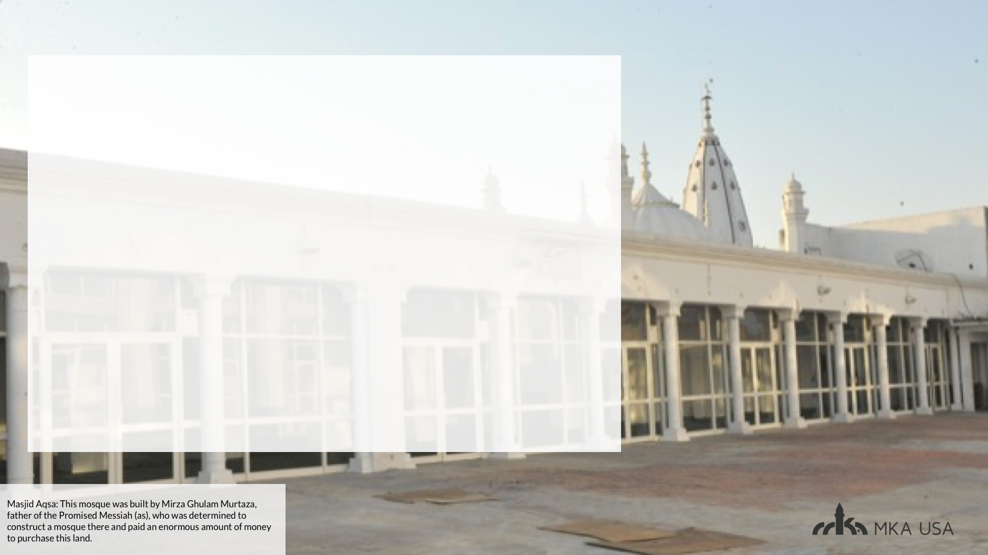
Another incident is related by Hadhrat Munshi Zafar Ahmad (ra) of Kapurthala, illustrating the Promised Messiah's humility in his dealings with fellow human beings, no matter who or what they were. He states that once the Promised Messiah (as) was returning from the Aqsa Mosque in Qadian when Miraan Bakhsh, a man of simple and confused mind who suffered from delusions, called out loudly and roughly after him, saying, 'O, Ghulam Ahmad'. The Promised Messiah (as) stopped and replied politely, saying, 'Yes'! (Such were the high morals of Hadhrat.) Miraan sometimes suffered from the delusion that he was a king and people needed to settle their accounts with him. Addressing the Promised Messiah (as), he said, 'Listen, you should say salaam'. The Promised Messiah (as) said, 'Assalamo Alaikum'. Miraan then said, 'You need to settle your account'. The Promised Messiah (as) took a coin from his pocket and gave it to him, which greatly pleased Miraan and he went off singing.' (It is recorded that as Hadhrat Munshi Sahib was narrating this event he sobbed uncontrollably at the memory of the beautiful character of his Holy Master.) (Ashab-e-Ahmad (Vol. 4) by Malik Salahudin M.A.)

Slide 6

Maulvi Ghulam Nabi was a very influential scholar and had a considerable following among the Muslims whom he delighted with his scholarly knowledge of the Qur'an and the Hadith. It was during this period of the Promised Messiah's stay in Ludhiana that Maulvi Ghulam Nabi used to bring with him a crowd of people to pitch outside the residence of the Promised Messiah (as) where they proceeded to pour out venom against him. The situation of the residence of the Promised Messiah (as) in Ludhiana was such that there was no through entrance to the men's reception room from the ladies' side and the Promised Messiah (as) had to approach the men's area externally. One day it so happened that as the Promised Messiah (as) was making his way to the men's reception room, Munshi Ghulam Nabi caught a glimpse of his face and this completely overpowered him. Prior to this occurrence he was busy delivering his usual speeches arousing the public's animosity against the Promised Messiah (as). Having seen the radiant face of the Promised Messiah (as), he rushed towards him and seeing him approach, the Promised Messiah (as) extended his hand, offering greetings of peace. Maulvi Sahib returned the greeting, took hold of his hand and accompanied him inside. Once inside, Maulvi Sahib not only sat close to the Promised Messiah (as), he also began to declare his love and admiration for him.
s
Being a scholar, naturally he raised many pertinent questions relating to the Promised Messiah's claim about the death of Jesus (as) and about his own Commission. The Promised Messiah (as) replied quoting references from the Holy Qur'an, to which Maulvi Sahib said: 'Certainly, the Holy Qur'an is with you'. The Promised Messiah (as) responded that if the Holy Qur'an was on his side, then on whose side was Maulvi Sahib? To this he immediately replied that he sided with the Promised Messiah (as), and at this he wished to take the Oath of Initiation. From that time on Hadhrat Maulvi Ghulam Nabi Sahib became totally immersed in the love of the Promised Messiah (as), paying frequent visits to Qadian, wishing never to leave his side (Report by Sheikh Abdur-Rahman Sahib (from Ansarullah magazine October 1995)).

Slide 7
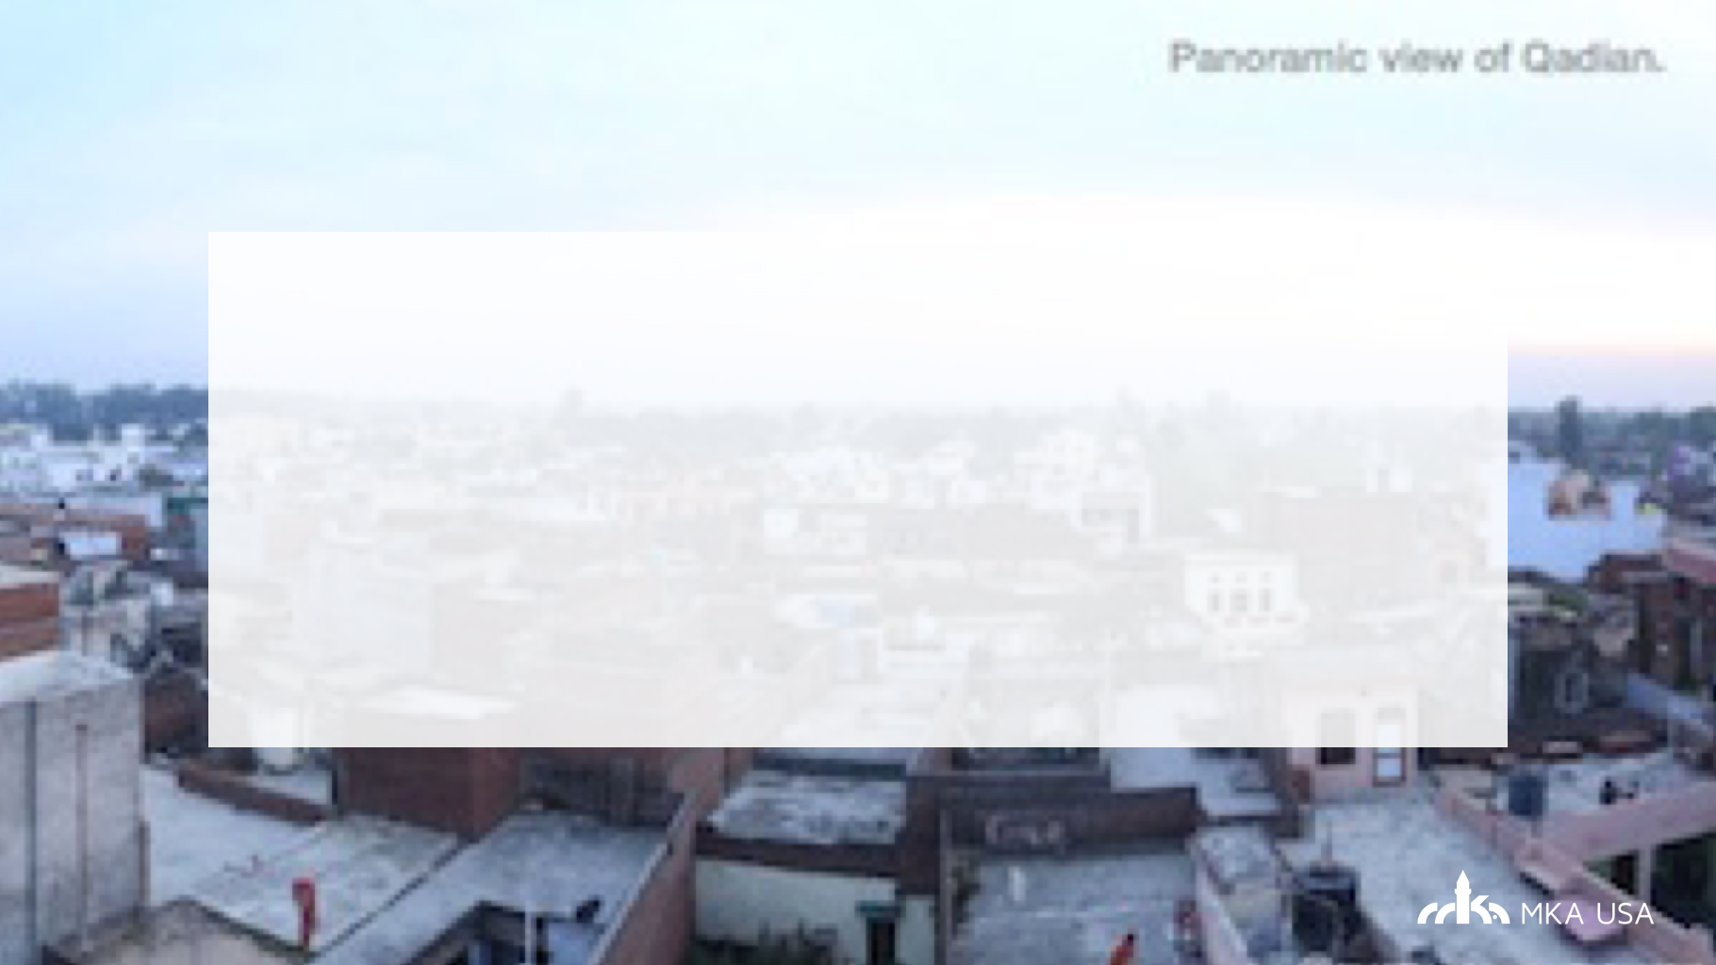
Extracts taken from:
“Al Islam.” A Life Sketch of the Promised Messiah,
www.alislam.org/library/links/00000185.html.
“Qadian – A Sacred Place of Spiritual Birth and Brotherhood for the Ahmadiyya Muslim
Community - The Review of Religions.” Qadian A Sacred Place of Spiritual Birth and
Brotherhood for the Ahmadiyya Muslim Community Comments,
www.reviewofreligions.org/11625/qadian-a-sacred-place-of-spiritual-birth-and-b
rotherhood-for-the-ahmadiyya-muslim-community/.

Slide 8
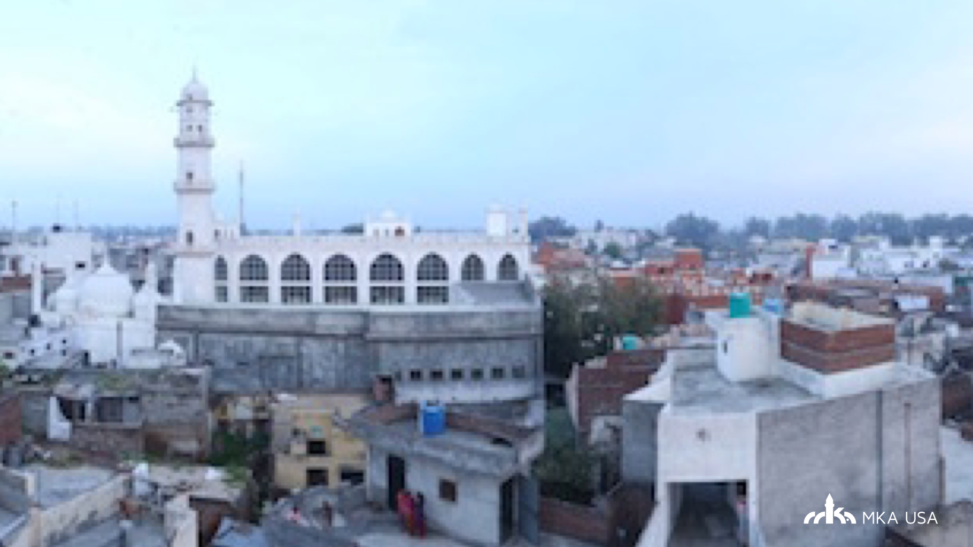

Slide 9
JEOPARDY!

Slide 10


Rules
Each team will have 30 seconds to answer the question.
If a team fails to answer a question, points will be subtracted from their score.
Partial answers will not be accepted.
Click on this icon to show the answer
Click on this icon to go to Home screen
>>>

Slide 11
Life of Holy Prophet ^{(sa)}
Life of Promised Messiah (as)
General Knowledge
Islamic “Golden Age”
Current Affairs
10
10
10
10
10
20
20
20
20
20
30
30
30
30
30
40
40
40
40
40
50
50
50
50
50

Slide 12
What was the pact/association in which the Holy Prophet ^{(sa)} entered into before prophethood in Makkah, whose oath he honored even after prophethood?
Hilf ul Fuzool
>>>

Slide 13
>>>

Slide 14
The Holy Prophet of Islam, Hazrat Muhammad ^{(sa)} once bravely marched alone to the door of Abu Jahl as a member of a society that he joined in Makkah which swore to protect the rights of the low and down-trodden. What did Abu Jahl see when he looked at the Huzoor ^{(sa)}?
Two wild camels standing on either side of him, ready to attack.
>>>

Slide 15
>>>

Slide 16
What did Huzoor ^{(sa)} say about his son Hazrat Ibrahim (as) who passed away in childhood?
(paraphrase OK) : If he had lived he would have been a prophet of God.
>>>

Slide 17
>>>

Slide 18
When Muslims are described as taking the bai'at of the Holy Prophet ^{(sa)} in the Holy Qur'an, how is it described?
Verily, those who swear allegiance to thee indeed swear allegiance to Allah. The hand of Allah is over their hands. So whoever breaks his oath, breaks it to his own loss; and whoever fulfils the covenant that he has made with Allah, He will surely give him a great reward. Surah Fath (48:11)
>>>

Slide 19
>>>

Slide 20
When (Hijri year) did the conquest of Makkah take place?
8th year of Hijri
>>>

Slide 21
>>>

Slide 22
What year did Hazrat Masih-e-Maud (as) found the Ahmadiyya Muslim Community?
1889
>>>

Slide 23
>>>

Slide 24
The book Al-Wasiyyat was first published in year ______?
1905
>>>

Slide 25
>>>

Slide 26
About whom did Hazrat Mirza Ghulam Ahmad Qadiani (as) state the following, “If I had not come, he would have surely come in my place.”
Hazrat Sahibzada Abdul Latif Shaheed (ra)
>>>

Slide 27
>>>

Slide 28
Who was the first martyr of Ahmadiyyat?
Hazrat Maulvi Abdur Rahman Shaheed (ra)
>>>

Slide 29
>>>

Slide 30
Promised Messiah (as) hypothesized that Arabic is the mother of all languages. What was the Arabic name of the book he wrote to prove this hypothesis?
Minan-ur-Rahman
(Some Favors of Beneficent God)
>>>

Slide 31
>>>

Slide 32
Which American historical figure is the city of Houston named after?
Sam Houston
>>>

Slide 33
>>>

Slide 34
Although DNA consists of the A, T, G, and C nitrogenous bases, RNA consists of A, ___, G, and C.
U
>>>

Slide 35
>>>

Slide 36
Which is the only state with a different design on the front and back of its flag?
Oregon
>>>

Slide 37
>>>

Slide 38
Hakeem Olajuwon played for the _____________ _______________. He fasted during Ramadan while playing for a national championship (and won)
Houston Rockets
>>>

Slide 39
>>>

Slide 40
Name and Country of the tallest waterfalls in the world?
Angel Falls in Venezuela
>>>

Slide 41
>>>

Slide 42
Who was the first Muslim to win a Nobel prize in science?
Dr. Abdus Salaam, Physics/Electroweak force
>>>

Slide 43
>>>

Slide 44
Muslims ruled Spain for around _______ years.
700-800 Years
>>>

Slide 45
>>>

Slide 46
_______ ___ ________ was the Muslim general who took the first foothold in Spain. He famously told his troops to burn their boats.
Tariq bin Ziyad
>>>

Slide 47
>>>

Slide 48
Who was the commander of the Army under whose leadership Muslims conquered Egypt for the first time?
Hazrat Amr bin Al-As (ra)
>>>

Slide 49
>>>

Slide 50
Who was the father of surgery?
Az-Zahrawi
>>>

Slide 51
>>>

Slide 52
Along with the falcon heavy, what did Elon Musk send in to space?
Tesla Roadster
>>>

Slide 53
>>>

Slide 54
Nick Foles is the first person to do this since Tom Brady did it in 2001?
Start the season as a backup quarterback and lead his team to a Lombardi Trophy
>>>

Slide 55
>>>

Slide 56
In a presidential greatness survey conducted every 4 years by Historians at the University of Houston and Boise State University, which president ranked first?
Abraham Lincoln
>>>

Slide 57
>>>

Slide 58
Name 3 Americans (first and last name) who earned a gold medal at the 2018 Winter Olympics in PyeongChang.
Mikaela Shiffrin, Shaun White, Red Gerard, Chloe Kim, Jamie Anderson
>>>

Slide 59
>>>

Slide 60
In the 2018 Winter Olympics, US hockey forward Jocelyne Lamoureux-Davidson broke the Olympic record for fastest two goals by one player. How far apart were the two goals?
Six seconds
>>>

Slide 61
The End!

