Slide 1


The Will
الوصیت
Monthly Taleem Focus Slides
April 2018

Slide 2
Wasiyyat: A Review
You might remember that the Taleem department released a set of slides on Al-Wasiyyat in September. In that set of slides we covered the purpose of Wasiyyat, it’s basis in the Quran, the requirements and responsibilities incumbent upon those who join, the prayers and wishes the Promised Messiah (as) had for those who enter into this institution, and the importance of Al-Wasiyyat according to some of the Khulafa.
  If you need to brush up on the material, you can download the September 2017 slides here: https://www.mkausa.org/download/201709-september-2017-taleem-monthly-focus-slides
  This month we’ll look at material asking us to join this program and cover the revolutionary nature of Wasiyyat.

Slide 3
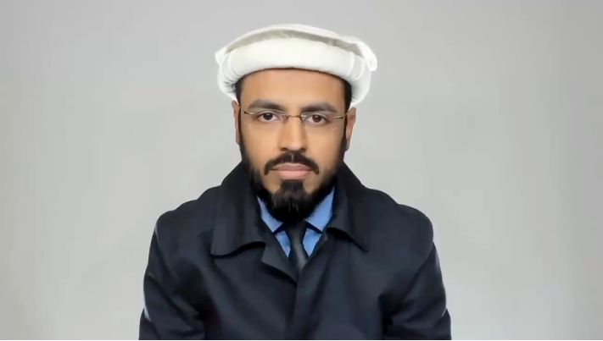
Video: Imam Rizwan Dispells Rumors Surrounding Al-Wasiyyat

Slide 4

Video: Former Sadr MKA, Faheem Younus: Are You Not Ready For Wasiyyat?

Slide 5
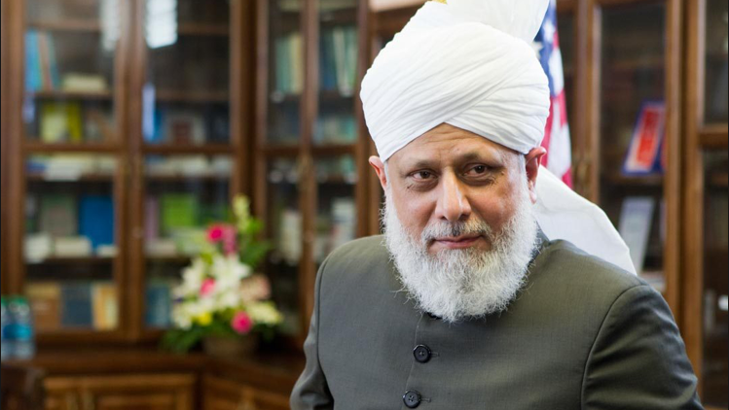
Video: Khalifatul Masih^{aba} on Wasiyyat

Slide 6
The New World Order
Hazrat Musleh Maud (ra) uses passages of Al-Wasiyyat to explain the grand future of Wasiyyat.
In The New World Order, he spends a considerable amount of time explaining the failures of communism and socialism.
  “A study of all these movements, however, reveals one feature common to them all: it is that the state ought to exercise a great deal more control over national wealth and sources of production than it has done in the past. Experience has shown that the old systems of taxation do not enable the State to provide an adequate system of relief and help for the poorer sections of the community. It is necessary, therefore, to devise a new means whereby a more equitable distribution of national wealth should become possible of achievement” (Nizam-e-Nau, p. 101).

Slide 7
Providing for the Needs of the Time
After explaining the various initiatives in addition to zakat the Khulafa-e-Rashideen created to support their citizens, Hazrat Musleh Maud explains the characteristics of Wasiyyat that take care of future economic needs:
  “The essentials of the Islamic and social economic system are: (1) that the needs of all human beings should be provided for; (2) that in trying to achieve the first object the incentive behind individual effort and enterprise should not be weakened; (3) that the system devised should be voluntary and should not involve forcible dispossession or confiscation; and (4) that the system should not be confined to one country or one nation, but should be universal...The appointed one of God, however, laid the foundations of the New Order in 1905 in his Al-Wasiyyat” (Nizam-e-Nau, p. 119-120).

Slide 8
The Need for Khuddam to do Wassiyat
Nearly 50 years have passed since the publication of The New World Order, and over 100 since the writing of Al-Wasiyyat.
By joining this system in this time of materialism, you again make a commitment to God that your wealth is for the sake of his servants.
If, like many youth in the world today, you are tired and frustrated with the way economic systems of the world exploit the weak and fail to take care of the poor, become a true activist by making a Will to support them.

Slide 9
Read Al-Wasiyyat and The New World Order
The Will is only 43 pages long, read it today!
  https://www.alislam.org/library/books/thewill/the_will.pdf
Schedule a weekend for The New World Order, the material can be dense at times
  https://www.alislam.org/library/books/Nizam-e-Nau.pdf

