Slide 1

Khalifa’s Love for the Jama’at and our Responsibilities
Monthly Taleem Focus Slides
May 2018

Slide 2
Personal Attributes of a Khalifa
Khilafat after Prophethood is a Divinely established institution and the Khalifa is chosen by Allah the Almighty
Being a Divinely chosen one, a Khalifa is bestowed with all the necessary attributes and capacities to:
  Lead the Jama’at and administer the system (Nizaam) of the Jama’at
  Establish a living relationship between Allah and the members of the Jama’at
  Using his Divinely granted wisdom, continuously guide the members about contemporary religious and worldly issues
  Feel the pain of the members and pray to Allah for them

Slide 3
Examples of Love and Compassion
The life of every Khalifa is full of countless stories of his love and compassion for the Jama’at. Some of such examples will now be presented from the life of each Khalifa of Promised Messiah^{as}

Slide 4
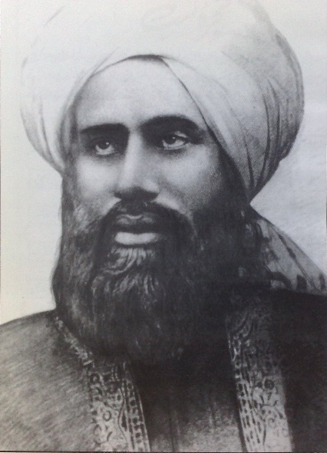
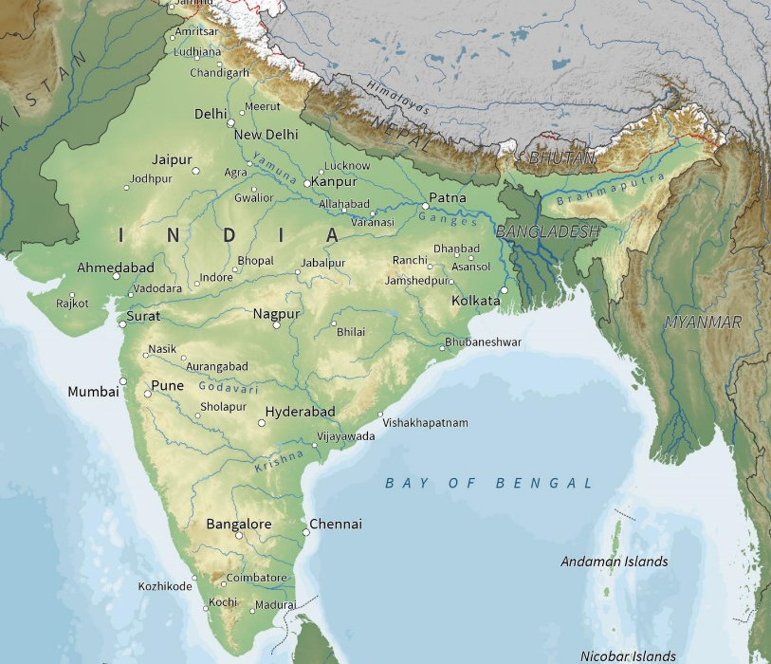
Khalifatul Masih I – Hadhrat Hakim Maulvi Nur-Ud-Din^{ra}
“In the autumn of 1908, Hyderabad city in South India was overtaken by a flood of extraordinary violence which inflicted terrible suffering upon the people. Entire quarters of the city were overturned and thousands of people were buried in the rubble and perished. Hadhrat Khalifatul Masih^{ra} dispatched several registered letters and urgent telegrams to obtain news about the community in the afflicted city, but in the confusion that prevailed none of them was delivered and, therefore, there was no response. He then sent Hafiz Abu Sa‘id Arab as his emissary to report on the situation. The letter that he received from the community in Hyderabad city thanking him for his concern about its members and his sympathy for them in their sufferings revealed how deeply he loved the members of the community and how anxious he was about their security and welfare.”
Qadian
1250 miles
Hyderabad
[Hadrat Maulawi Nur-Ud-Din^{ra} by Muhammad Zafrullah Khan^{ra} (Page 193)]

Slide 5
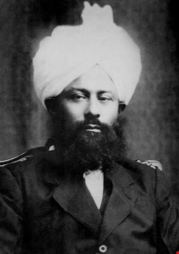
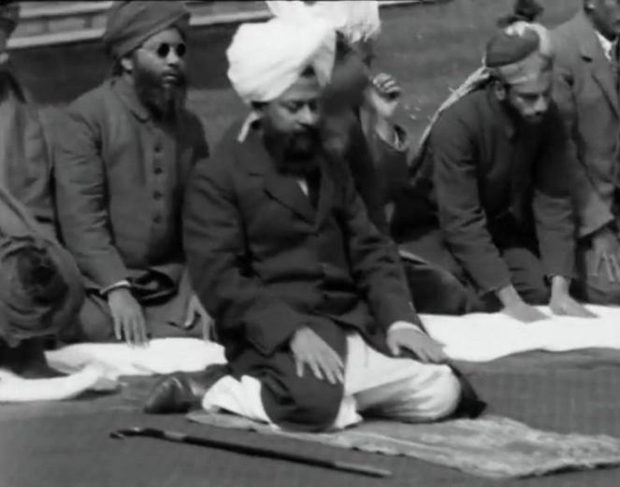
Khalifatul Masih II – Hadhrat Mirza Bashirud Din Mahmood Ahmad^{ra}
Hadhrat Musleh Maud^{ra} shed light on the Khalifa’s spiritual and emotional attachment with his followers (i.e. the Jama’at) by saying:
“Generally speaking, is there any difference between you and those who have turned away from Khilafat? There seems to be no difference. Yet, you should remember that there is one big difference! And that is that:
You have someone who has true sympathy for you; who truly loves you; who considers your pain and sufferings to be his own; and who is always praying to Allah for you”
[Barakaat-e-Khilafat by Hadhrat Mirza Bashirud Din Mahmud Ahmad^{ra} (Page 6 of the English rendering)]

Slide 6
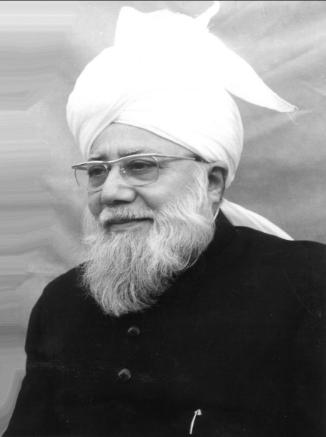
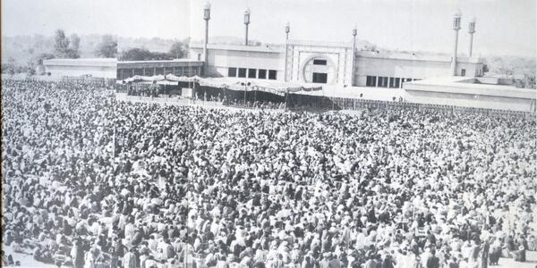
Khalifatul Masih III – Hadhrat Mirza Nasir Ahmad^{rh}
“In Rabwah once thousands of people were anxiously awaiting the chance of meeting Huzur in person. The first appointment had been booked for eleven in the morning. But at ten o’clock Huzur had an acute attack of bodily weakness and Doctor Mirza Munawar Ahmad came to see him. For an hour, Huzur was given medicine and Dr. Mirza Munawar Ahmad recommended that all official engagements be cancelled and the appointments deferred. But Huzur observed that people had come from far away places to meet him and that he would see them even if he had to recline on a bed! So in spite of the medical opinion, this selfless person met each and everyone of the people. He did not retire until he had met everyone.”
[A glimpse into the Life of Hazrat Khalifatul Masih III by B. A. Rafiq (Page 16)]
A view of Jalsa Salana Rabwah, Pakistan

Slide 7
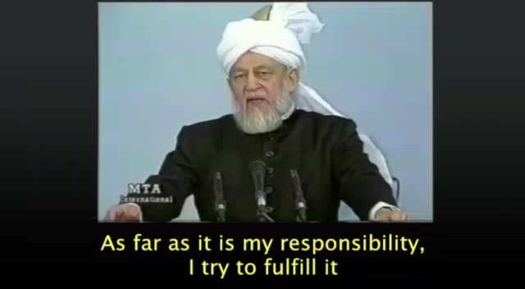
Khalifatul Masih IV – Hadhrat Mirza Tahir Ahmad^{rh}
This video shows an example of the extreme love and concern Huzur^{rh} had about the spiritual wellbeing and the worldly success of the Jama’at members
Please pay attention to the English subtitles

Slide 8
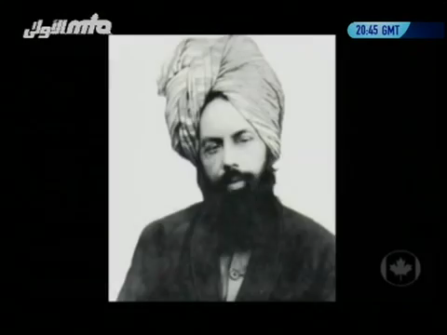
Blessings of Khilafat and our Responsibilities

Slide 9
Take Home Message
Khalifa of the time is full of sincere love and compassion for us. He feels our pain and devotedly pray to Allah for our wellbeing and protection. In return, WE must realize and fulfill our obligations towards the institution of Khilafat. We must pray for our Khalifa, obey him and assist his mission in every possible way!
Khuddam should make an effort to write a letter to Khalifatul Masih at least once a month.
(Type and email your letter to letters@mkausa.org)

