Slide 1

Understanding Concerns
Approaching Atheism (Part 1)
Monthly Taleem Focus Slides
September 2018

Slide 2
What is Atheism?
Atheists firmly believe in no higher power. For our purposes today, we will consider a more general definition that encompasses those who do not adhere to any organized religion.
35% of Americans are unaffiliated, meaning that they are either atheist, agnostic, or follow no organized religion but consider themselves spiritual¹. About 1/3 of this population is under the age of 30
1. Source: https://www.youtube.com/watch?v=HIiPDDlwCm0

Slide 3
Why is Atheism so Popular?
Some factors that play a role in the decision to become atheist
  The actions of religious leaders (clergy engaging in misconduct, terrorism)
  The attitudes of religions towards prevailing societal issues such as homosexuality, drug usage, and abortion.
  The manners in which families raise their children according to religious principles (some families don’t know how to deal with objections to religion, some are incredibly strict, while others don’t truly practice their religion).
1. Source: https://www.youtube.com/watch?v=HIiPDDlwCm0

Slide 4
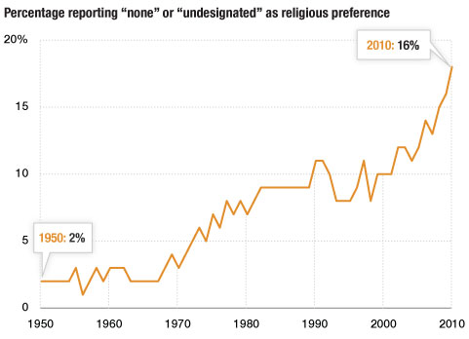
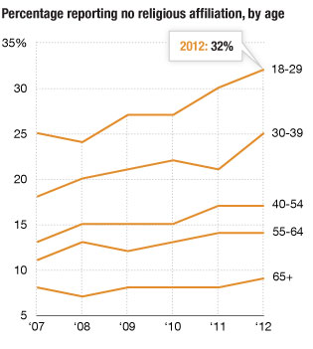
Growth of Atheism since 1950 and Age Breakdown
https://www.npr.org/sections/thetwo-way/2013/01/14/169164840/losing-our-religion-the-growth-of-the-nones

Slide 5

Interpreting the Data
Robert Putnam, a political scientist at Harvard University,
says on the trend of younger people becoming unaffiliated with religion, "It begins to jump at around 1990..These were the kids who were coming of age in the America of the culture wars…religion publicly became associated with a particular brand of politics, and so I think the single most important reason for the rise of the unknowns is that combination of the younger people moving to the left on social issues and the most visible religious leaders moving to the right on that same issue."
https://www.npr.org/sections/thetwo-way/2013/01/14/169164840/losing-our-religion-the-growth-of-the-nones

Slide 6
What Does This Mean About Our Approach to Atheism?
Before putting forward logical arguments for the existence of God, it is helpful to understand some of the causes for why people have turned to atheism in the first place.
  Atheism is not always a result of logical inquiry into religion, it can also be the result of an emotional reaction.
One underlying cause in the societal causes for atheism is the problem of evil.
  Why do so many religious people endorse pain?
  Why would a loving God allow suffering to exist in the world?

Slide 7

The Problem of Suffering Solved From An Evolutionary Perspective (Video)

Slide 8
Further Reading
Barahin-e-Ahmadiyya - The Promised Messiah^{as} (Focuses on the functions of reason and revelation and rational proofs for the existence of God from the Holy Quran).
Haqiqatul Wahi – The Promised Messiah^{as} (on proving the existence of revelation)
Our God – Hazrat Mirza Bashir Ahmad^{ra} (gives numerous arguments and proofs for the existence of God)

