Slide 1

Does God Exist?
Approaching Atheism (Part 2)
Monthly Taleem Focus Slides
October 2018

Slide 2
Three Kinds of Atheists
1. Those who do not believe in God because they do not find any convincing evidence to prove His existence. This is the majority group among the atheists and represents over 90% of them.
2. Those who believe that the question of the existence or non-existence of God cannot be proved through reason. For all practical purposes, these people too do not believe in God.
3. Those who positively deny the existence of God and claim that they can prove His non-existence through arguments. But this claim also largely rests on the assertion that there is no proof of the existence of God. These people form a very small minority, and probably account for less than one percent of all the atheists.
Western atheists have chosen for themselves the name 'agnostics', which literally means that they do not have the knowledge. They say that though they do not have positive proof of the existence of God, they cannot deny it either. These people form the largest group among atheists.
1. Source: Our God (by Hazrat Mirza Bashir Ahmad, M.A.)

Slide 3
Existence of God
“If someone says that he would not believe in God unless he sees Him with his own eyes, all I should say is that if God could be seen with one’s eyes, He would not be worth believing at all. This is because in such case many of His other attributes would be falsified....He is Infinite but would become finite and so on and so forth.
….The Beauty of God lies in His being Hidden from our physical eyes and
yet being apparent to us; He is Subtle but remains more evident and
perceptible than material things. Unfortunate indeed is he who does not
comprehend this subtle truth, for he stands on the brink of disaster.”
1. Source: Our God (by Hazrat Mirza Bashir Ahmad, M.A.)

Slide 4
Famous Quotes
Sir Issac Newton is regarded as the greatest of all the scientists that the world has produced. According to him the universe could not be explained without belief in God. He says:
"This most beautiful system of the sun, planets and comets could only proceed from the counsel and dominion of an intelligent and powerful Being.”
(Our Solar system and the Stellar Universe, by Charles Whyte, p.131 Charles Griffin & Co. Ltd. London 1923)
Dr. Albert Einstein is one of the greatest scientists of the twentieth century. He says:
"My religion consists of a humble admiration of the illimitable superior spirit who reveals himself in the slight details we are able to perceive with our frail and feeble minds. That deeply emotional conviction of the presence of a superior reasoning power, which is revealed in the incomprehensible universe, forms my idea of God.“ (The Universe and Dr. Einstein, by Lincoln Bsrnett p.118, Mentor 1950)
Galileo wrote as follows:
"I am quite beside myself with wonder and infinitely grateful to God that it has pleased Him to permit me to discover such great marvels". (The Growth of physical Science by Sir James Jeans p.173, Cambridge 1951)
https://www.alislam.org/library/books/Views_of_Scientists_on_Existence_of_God.pdf

Slide 5
Allah Says in the Holy Quran:
Allah it is Who created the heavens and the earth, and that which is between them. (32:5)
Say, ‘Allah alone is the Creator of all things, and He is the One, the Most Supreme. (13:17)
He is Allah, the Creator, the Maker, the Fashioner. His are the most beautiful names. (59:25)
Glorify the name of thy Lord, the Most High, Who creates and perfects, And Who designs and guides. (87:2-4)

Slide 6
In the Words of Promised Messiah (as)
“How truly unfortunate is the person who still does not know that he has a God Who has power over everything. Our Paradise is in our God, our highest delight is in our God, for we have seen Him and have found every beauty in Him. This wealth is worth procuring even if it be at the cost of one’s life; this ruby is worth purchasing though one may have to lose one’s self to acquire it. O ye who are bereft! Run to this fountain, for it will satiate your thirst. It is the fountain of life that will save you. What shall I do, and how am I to impress this glad tidings upon the minds? By what drum shall I make the announcement so that people might hear that this is your God? What remedy shall I apply to their ears so that they hearken?” (Kashti-e-Nuh)

Slide 7
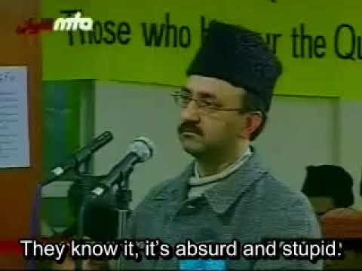
God & Evolution (Video)
https://youtu.be/e7nfUgaNHXc

Slide 8
Further Reading
Barahin-e-Ahmadiyya - The Promised Messiah^{as} (Focuses on the functions of reason and revelation and rational proofs for the existence of God from the Holy Quran).
Haqiqatul Wahi – The Promised Messiah^{as} (on proving the existence of revelation)
Our God – Hazrat Mirza Bashir Ahmad^{ra} (gives numerous arguments and proofs for the existence of God)

