Slide 1
  Ai’tmad Departmental Plan
  2018-2019
  Ahmed Bajwa
  Serving as Motamid MKA USA
  motamid@mkausa.org

Slide 2
Monthly Goals
Hold monthly General and Amila meetings
  Resources: https://www.mkausa.org/meetings
  Count local/regional/national Ijtema’at
Submit monthly report by 5th every month
  https://www.mkausa.org/reports
Notes:
Qaid is sometimes burdened with a lot of work. Off load work to Motamid (create agenda, set up meetings)
Sample agenda shared
Every majalis is required to submit a report, regardless if there has been activity or not. It is better to submit a blank report than not reporting at all. All of this information is consolidated and sent to Huzur every month.

Slide 3
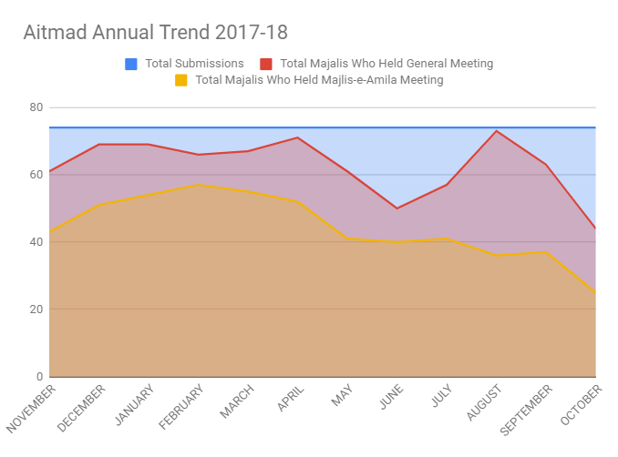
2017-18 Performance

Slide 4
Successes/Challenges
Challenges:
  Communication to local Qaideen/Nazimeen
    Telegram Qaideen Admin Group, Qaid Email account
    Telegram Department Groups
  Regularity in holding Monthly General and Amila meetings
Successes:
  Telegram
  @mkausa.org accounts/Google Drive
  Creation of Interactive quizzes using Kahoot
  Creating local annual/monthly calendar of activities / Plan ahead
Notes:
The biggest challenge the Aitmad department faces today is communicating to local Qaideen and Nazimeen. To make communication easy, the Qaid should:
Use mkausa email address (main avenue of communication)
Submit local amila (so we are not bombarding qaideen with emails/muhtaimimeen will contact nazimeen)
Set up telegram and join the appropriate group chats
Submitting local Amila is important so the Muhtaimimeen can directly be in contact with local Nazimeen so the Qaid is not overwhelmed with emails.

Slide 5
Demos
  Hafiz (MKA Knowledge Library)
    https://hafiz.mkausa.org/
  National/Local Calendar - Google Calendar
  Google Groups (Local Email Distribution Group)
  Google Meet (Video and audio Conf for meetings)
  Monthly Report
    https://www.mkausa.org/reports

Slide 6
  Resources
Calendar: https://www.mkausa.org/calendar/
https://drive.google.com/file/d/1CCCQ-_NLIoTVmGnex36V_5bg7RiW5-eX/view?usp=sharing
Import to your Calendar: https://calendar.google.com/calendar?cid=ZDhlNmNvdHZnaGdxNjEyMGJzMWs2YW9kY29AZ3JvdXAuY2FsZW5kYXIuZ29vZ2xlLmNvbQ
iCal Format: https://calendar.google.com/calendar/ical/d8e6cotvghgq6120bs1k6aodco@group.calendar.google.com/public/basic.ics
Monthly Reports submission: https:.//www.mkausa.org/reports
Monthly Meeting Resources: https://www.mkausa.org/meeting
MKA Constitution: https://www.mkausa.org/download/15430/
Qaid handbook: https://www.mkausa.org/download/qaid-handbook-2/
https://hafiz.mkausa.org/article-categories/qaid-handbook/
Hafiz: https://hafiz.mkausa.org
Video Conference Call options: https://zoom.us/ (40 min free and then reconnect)
Other free Conference Call option: Google Meetup
Setup interactive quizzes for meetings: https://kahoot.com/
Broadcast Text Messaging Service: https://flocknote.com/ (Free for upto 4o members)

Slide 7
Importance of MKA/Jama’at Meetings
“That day is near when those who work for Ahmadiyyat will acquire stature. But, the children of those who do not take interest in Jama`at work now will be shunned. When nations like England and America will send their representatives for advice and they will consider this to be source of respect for them, then the children of these people will ask to be included in the advices. But, then they will be told, Go! your parents and grandparents rejected the advices in their time and did not care about the work of Jama`at, hence you cannot be included in this process either.
Therefore, remove this ignorance and create this awareness in you that a person who attends a meeting of Jama`at is rewarded so much that the membership of the council of America is nothing in front of it. Even if he must make hundred compromises to attend this meeting, he must do so. If he does not attend the meeting than the system of Jama`at will not suffer because of his absence, rather he will be deprived of the rewards of Allah”
(Majlis Shura 1956, page 24-25) Hadrat Khalifatul Masih II (ra)

