Slide 1
Khidmat-e-Khalq
Department Plans 2018-19

Slide 2
Constitution
Mohtamim Khidmat e Khalq shall adopt such means as to do maximum service to the poor, helpless, and needy without any discrimination of religion, creed, cast and color.
He shall continue trying to eliminate unemployment and poverty among the society
Khidmat-e-Khalq

Slide 3

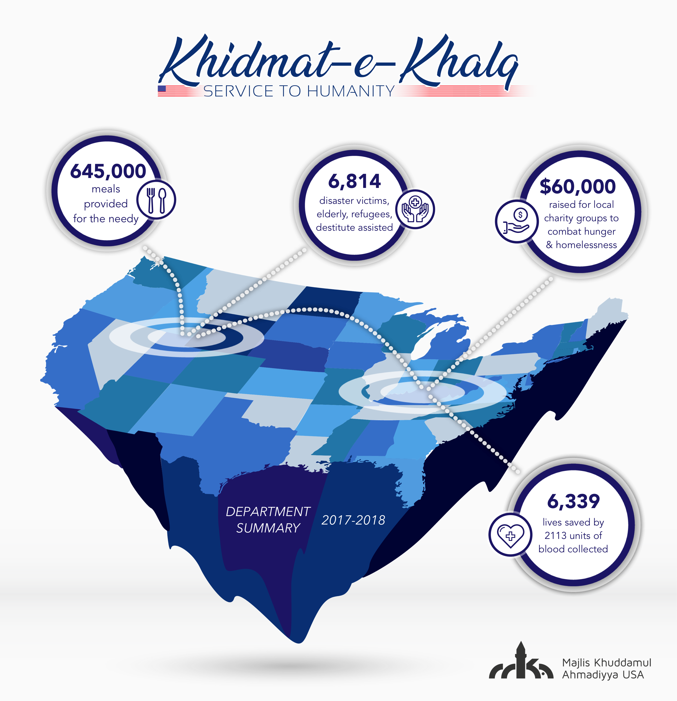
Khidmat-e-Khalq

Slide 4
Feeding the Needy
Collect food items at the Masjid
Participate in Mass Feeding programs with other organizations
Organize your sandwich packing & distribution sessions.
Last year: 645,000 fed Goal: 1 million fed

Slide 5
Giving in Charity
Till February focus is on fundraising for Tahir Homeopathic Hospital (Rabwah)
Individual majalis have fundraising goals
  Charity dinner/BBQ
  Volunteer to assist fundraising drives by local charities & Walk for Humanity fundraising
  Hilf Al-Fudul society: raise $1000 in donations, help pack 1000 meals and donate blood twice (will be rolled out soon)
Last Year: $60,000 raised Goal: $500,000

Slide 6

Blood Drives
Organize Blood drives at your Masjid/college campuses
Join other organizations and volunteer at Blood Drives
During emergency situations, we should focus on holding Blood Drives
Time Period: Throughout year, but heavy focus during September 11th
Last Year: 2113 units Goal: 8000 Blood Units

Slide 7
Helping elderly, needy and refugees
Assist the vulnerable in the society:
  Orphans, Widows, Elderly, Victims of Abuse, Refugees
  Gift giving at nursing homes for elderly
Last Year: 6339 Helped
Goal: 10,000 Helped

Slide 8
Disaster Relief
During disasters, look into feasibility to have Khuddam volunteers at shelters, assisting with rescue etc
Collaborate with Humanity First
Goal: Respond to disasters in a timely manner

Slide 9
Holiday Gift Giving
Dec-Mid January, give gifts to neighbors around the Mosque
Visit nursing homes for the elderly
Post pictures on Social media and send press release out to media
Eid gift giving
Last Year: ~30 Majalis participated
Goal: 50 Majalis participation

Slide 10
Visiting a Graveyard
Visit local Graveyard with fellow Khuddam and talk about the significance of Visiting the Deceased
Take an elder familiar with deceased jamaat pioneers with you
Time Frame: April

Slide 11
Contact
Abdul Naseer MK
Cell: 952 212 4118
Mohtamim Khidmat e Khalq
Khidmat-e-Khalq@mkausa.org

