Slide 1

Khidmat-e-Khalq
Department Plans 2014-15

Slide 2
Constitution
Mohtamim Khidmat e Khalq shall adopt such means as to do maximum service to the poor, helpless, and needy without any discrimination of religion, creed, cast and color.
He shall continue trying to eliminate unemployment and poverty among the society
Khidmat-e-Khalq

Slide 3
Feed 3 & Save 6
Every Khadim-
Feed 3 people per month: GOAL – 100,000 people fed during the year
Donate Blood and bring a friend – (2 pints/yr): GOAL: 5000 pints of blood collected
Visit or Help those in need (including the sick, indigent, widows, orphans, handicapped, and/or battered women)

Slide 4
Resources
We will reach out to each Nazim Khidmat e Khalq every Quarter
We can hold conference calls regarding organizing blood drives, soup kitchens, and food drives if interested
Visit the mkausa.org website for ‘How to’ documents
Khidmat-e-Khalq

Slide 5
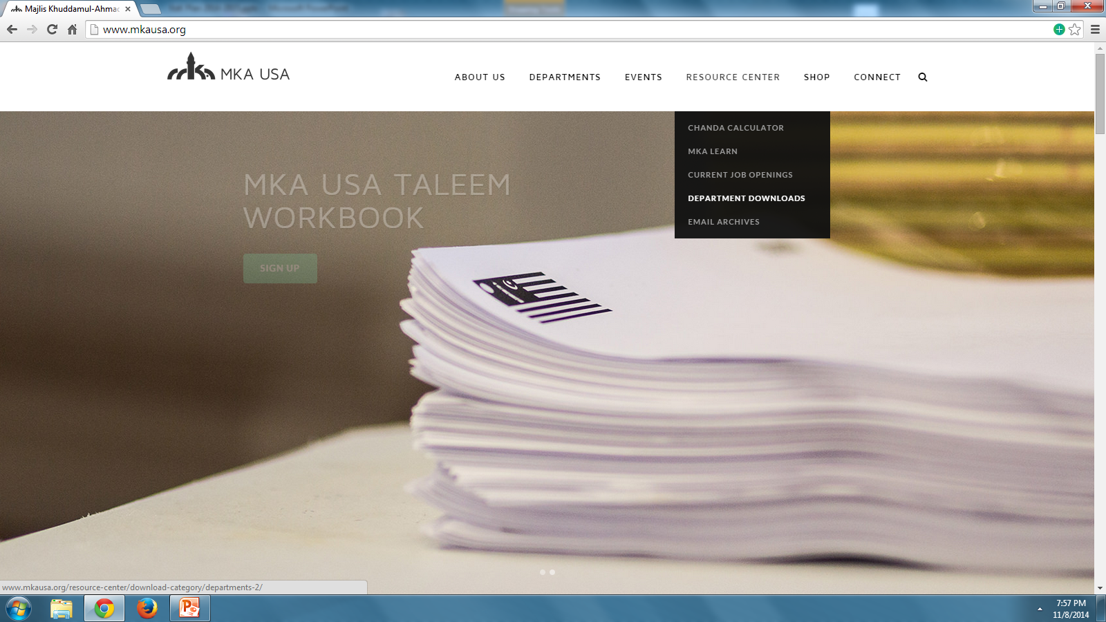

Slide 6
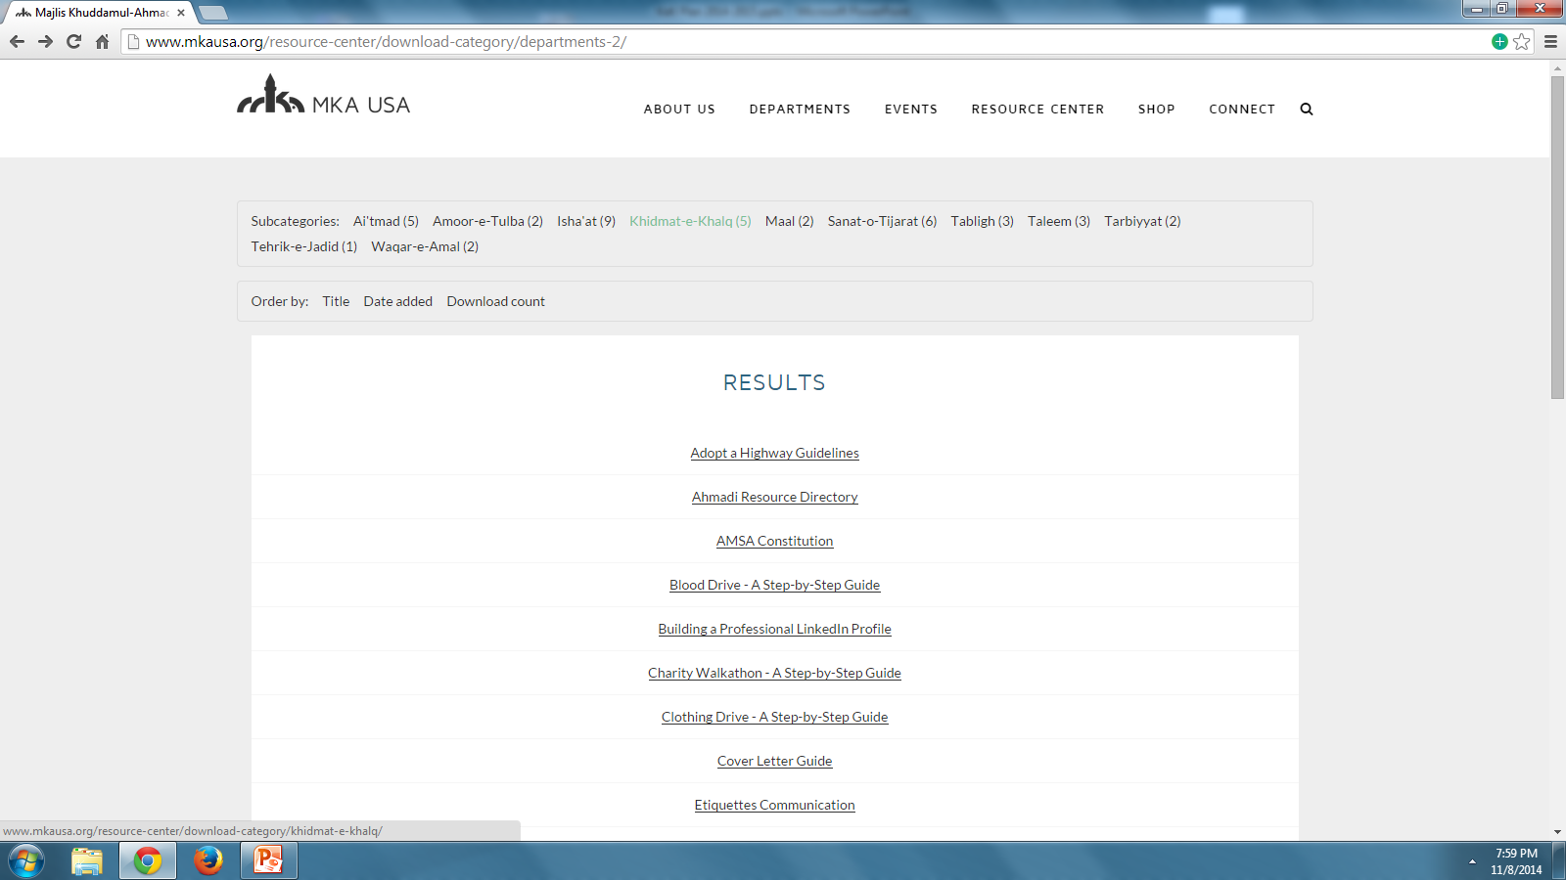

Slide 7
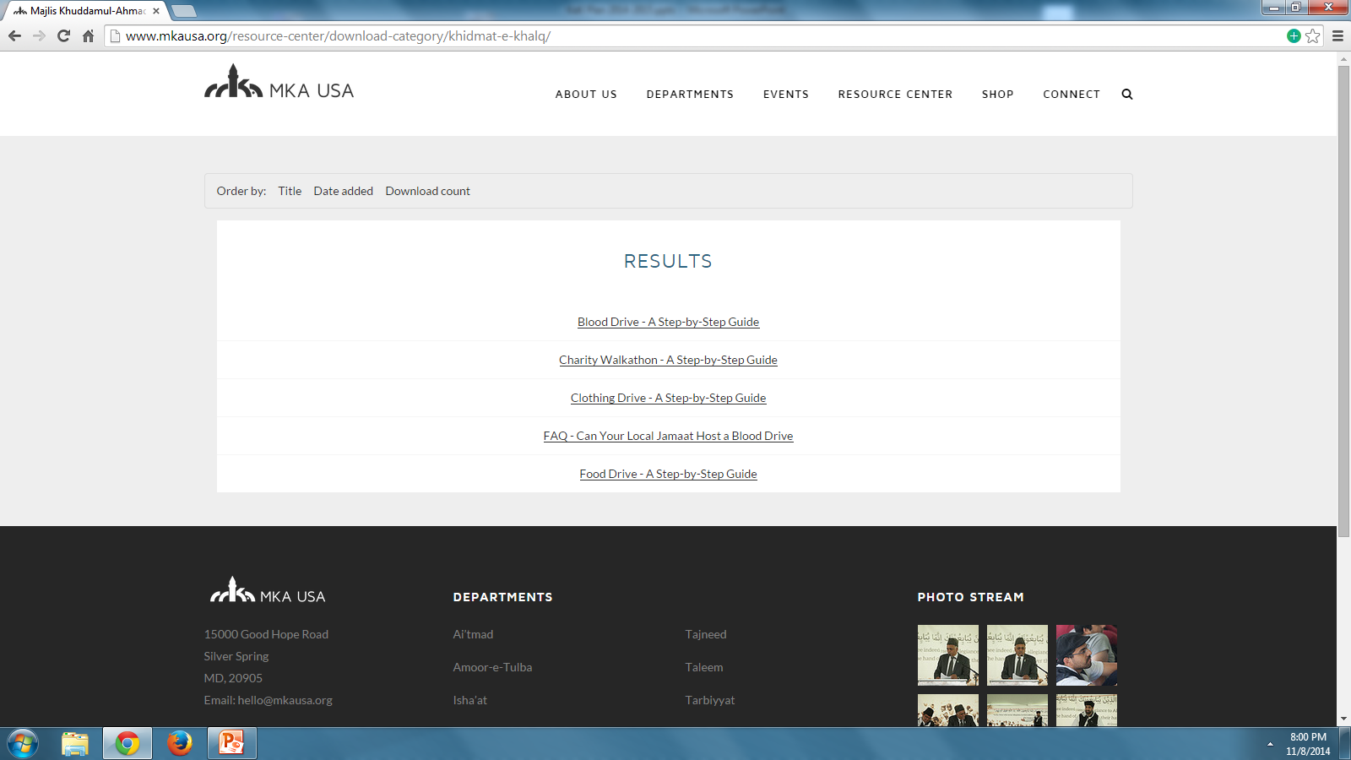

Slide 8

Feed 3 & Save 6 Campaign
Every Khadim Should:
Feed 3 people/month
- GOAL: 100,000/year
Donate Blood and bring a friend
- GOAL: 5000 pints/year
Visit or Help those in need (including the sick, indigent, widows, orphans, handicapped, and/or battered women)
AHMADIYYA MUSLIM YOUTH ASSOCIATION
Department of Humanitarian Services

Slide 9
Khidmat-e-Khalq
Mohtamim
Madeel Abdullah
madeel.abdullah@mkausa.org
610-761-5476
Naib Mohtamim
Mahir Osman
mahir.osman@mkausa.org
586-703-1068
Naib Mohtamim
Nadim Malik
nadim.malik@mkausa.org
646-418-2995
AHMADIYYA MUSLIM YOUTH ASSOCIATION
Department of Humanitarian Services

