Slide 1

Khidmat-e-Khalq
Department Plans 2016-17

Slide 2
Constitution
Mohtamim Khidmat e Khalq shall adopt such means as to do maximum service to the poor, helpless, and needy without any discrimination of religion, creed, cast and color.
He shall continue trying to eliminate unemployment and poverty among the society
Khidmat-e-Khalq

Slide 3
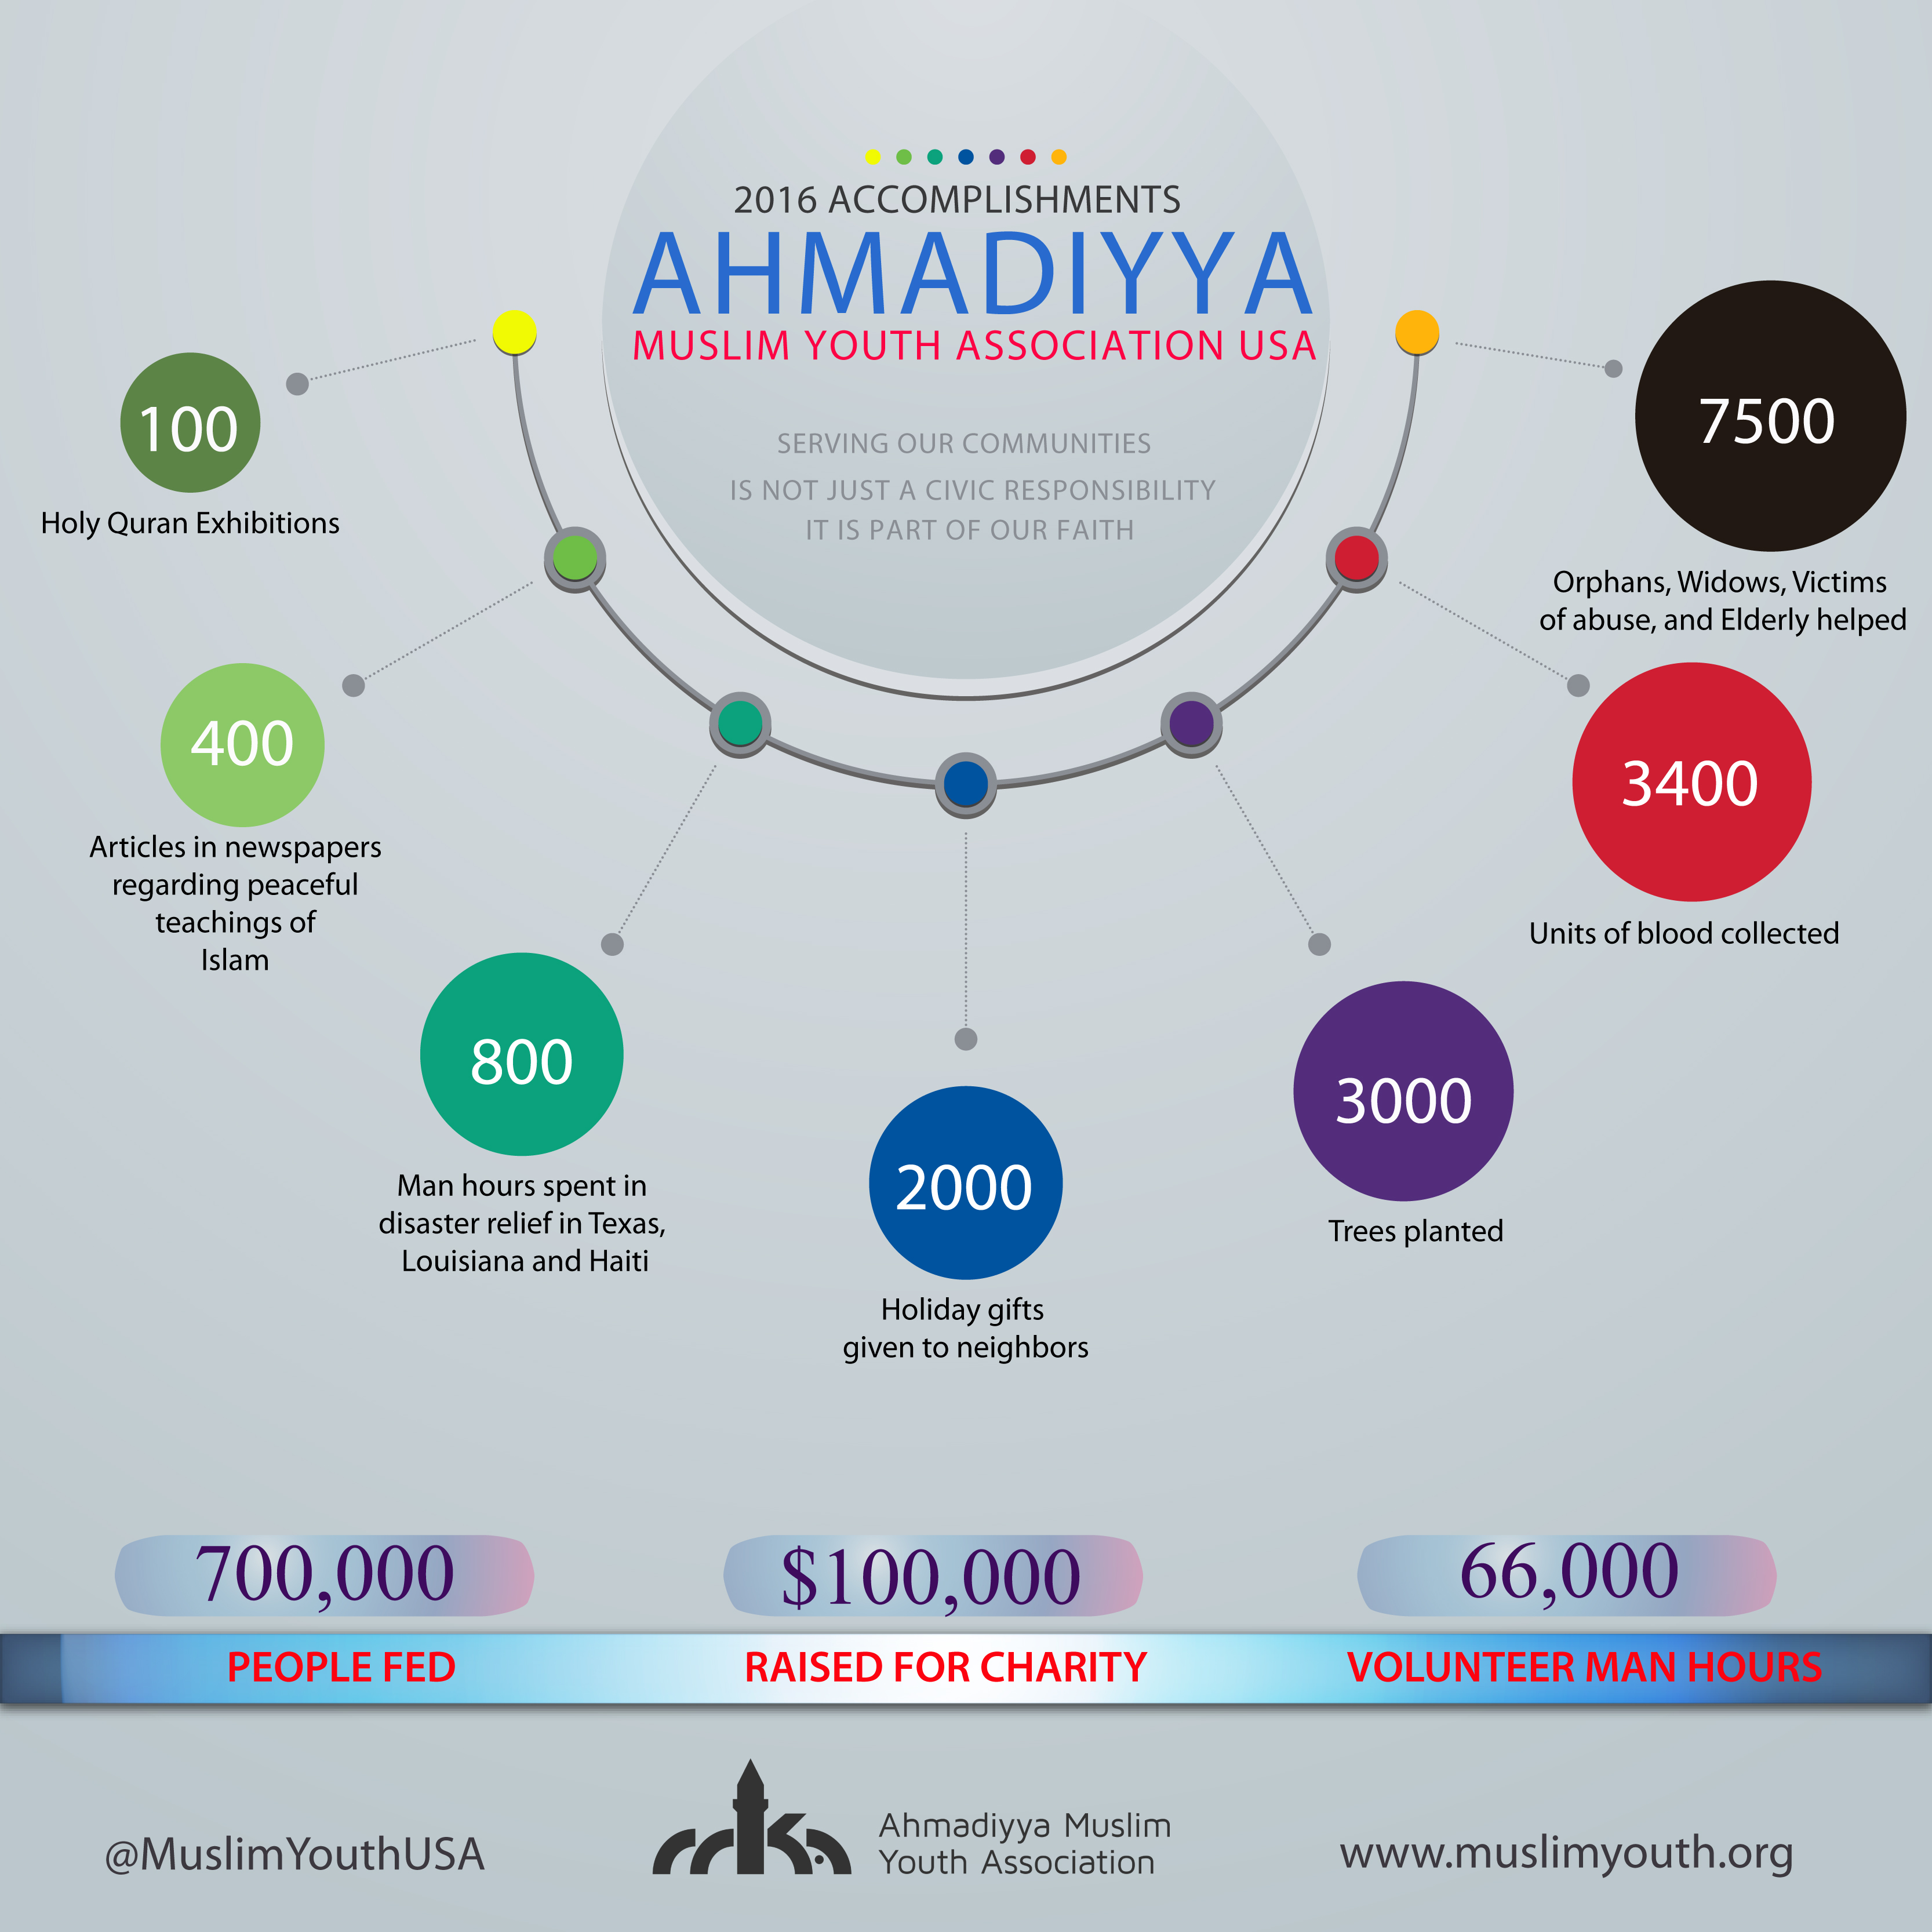
Khidmat-e-Khalq

Slide 4
Feeding Programs
Collect food items at the Masjid or Food Pantry
Participate in Mass Feeding programs with other organizations
Organize your own soup kitchens
Last year: 700,000 fed Goal: 1 million fed

Slide 5
Blood Drives
Organize Blood drives at your Masjid
Join other organizations and plan Blood Drives
If there as any National or International Tragedy, we should focus on holding Blood Drives
Time Period: Throughout year, but heavy focus during September 11th
Last Year: 3400 Goal: 5000 Blood Units Collected

Slide 6
Helping those in Need
Depending on your Majalis, consider helping others in need including:
  Orphans, Widows, Elderly, Victims of Abuse, Refugees
Last Year: 7500 Helped
Goal: 10,000 Helped

Slide 7
Disaster Relief
During any Natural Disaster, we can see feasibility to send Khuddam to these sites
Work alongside Humanity First to help with logistics and funding
Last Year: 800 man hours
Goal: 1000 Man Hours for Disaster Relief

Slide 8
Holiday Gift Giving
During Holiday season, give gifts to neighbors around the Mosque and your homes
Post pictures on Social media and send press release out to media
Last Year: 2000 gifts given man hours
Goal: 4000 gifts

Slide 9
Visiting a Graveyard
Visit local Graveyard with fellow Khuddam and talk about the significance of Visiting the Deceased
Take an elder with you
Time Frame: May – Lahore Attacks and Memorial Day

Slide 10
Contact
Madeel Abdullah
Cell: 610 761 5476
Mohtamim Khidmat e Khalq
Khidmat-e-Khalq@mkausa.org

