Slide 1
Maal Best Practices
2018-2019

Slide 2


Slide 3
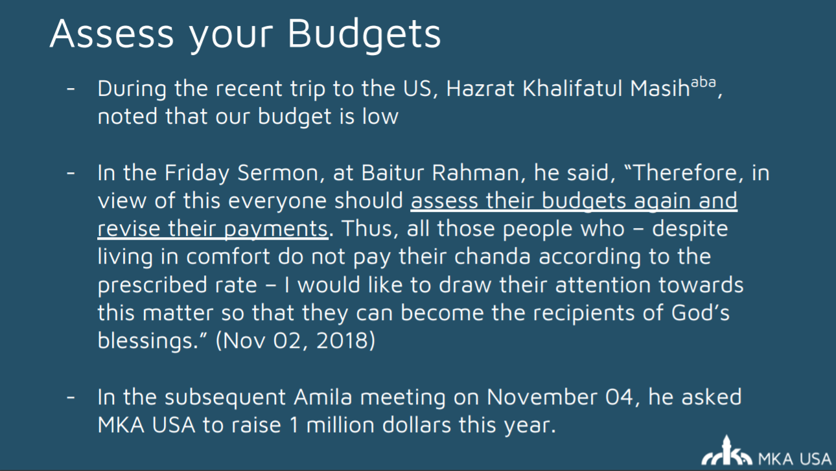

Slide 4
More on Budgets
Let’s do this right!
Belief…
Calls, calls, calls!

Slide 5
Collection Tips
  Never be ashamed to ask for chanda…
  Know everyone in your majlis. Really know them. What they do, what they like, build a relationship with them. If the only time you talk to them is for chanda then it’s not going to work
  Don’t put off the collection till the end of the year
  Get people to sign-up for auto-pay
  Get easy ones (students) done early so you have less to focus on
  Focus on those who haven’t paid last year
  Every month contact at least half your majlis for collection
  Don’t sit on checks. Deposit weekly

Slide 6
Other Income Reminders
Money in should match El Hesab (finance system)
Venmo use will be monitored this year. Need logins and can only tie logins to MKA email address

Slide 7
Expense
Money out should only be aligned to approvals/expenses
Some Majalis are still not on BOA. Muhtamim Sb sent heads up to begin processing. We will be doing in person audits this year.
Expenses will be checked for the proper approvals and we will perform our own reasonableness assessment
Need to keep local share in mind. If you overspend, no matter if it's all appropriate, you will be zeroed out and will even have to have maal department put a “pull” on your funds.
What are we spending money on? Should be keeping an eye on this, even if your expenses are all approved. Think about if there is a better way you could be spending your funds. Consider creating a local budget.
Debit Card ownership and usage

Slide 8
Other Topics
El Hesab -> new system
Online Payments -> expansion
Expense Portal -> new system
Future Plans

Slide 9
Questions? Contact Us
Title | Name | Email | Phone
Mohtamim Maal | Yasir Mirza | maal@mkausa.org yasir.mirza@mkausa.org | 512-669-6805
Muhasib | Zarik Khan | zarik.khan@mkausa.org | 630-309-2640
Numerous other team members

