Slide 1
MKA Umoomi
Disaster Preparedness Activities
Ahmed Sadiq Bajwa
Serving as Mohtamim Umoomi
National Director of General Affairs
umoomi@mkausa.org
571.215.6053

Slide 2
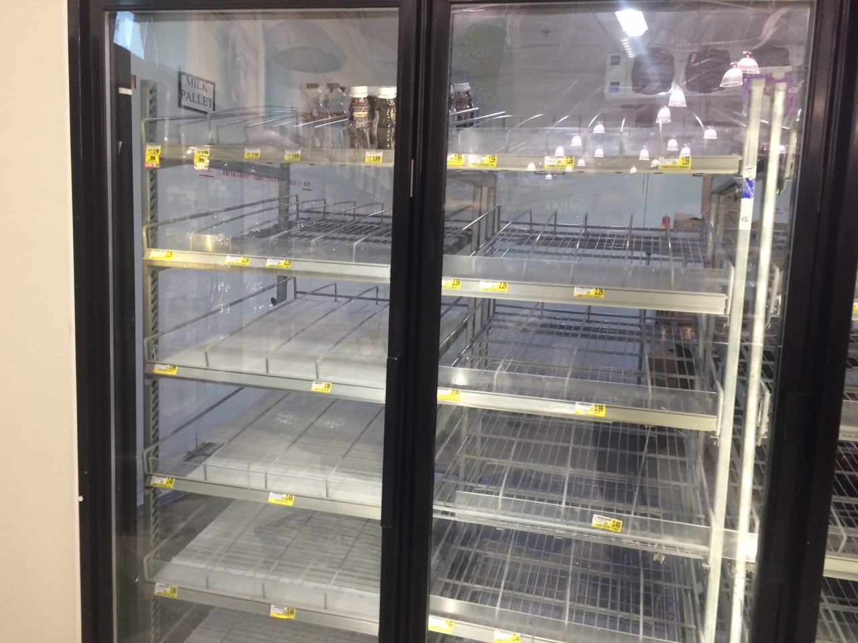
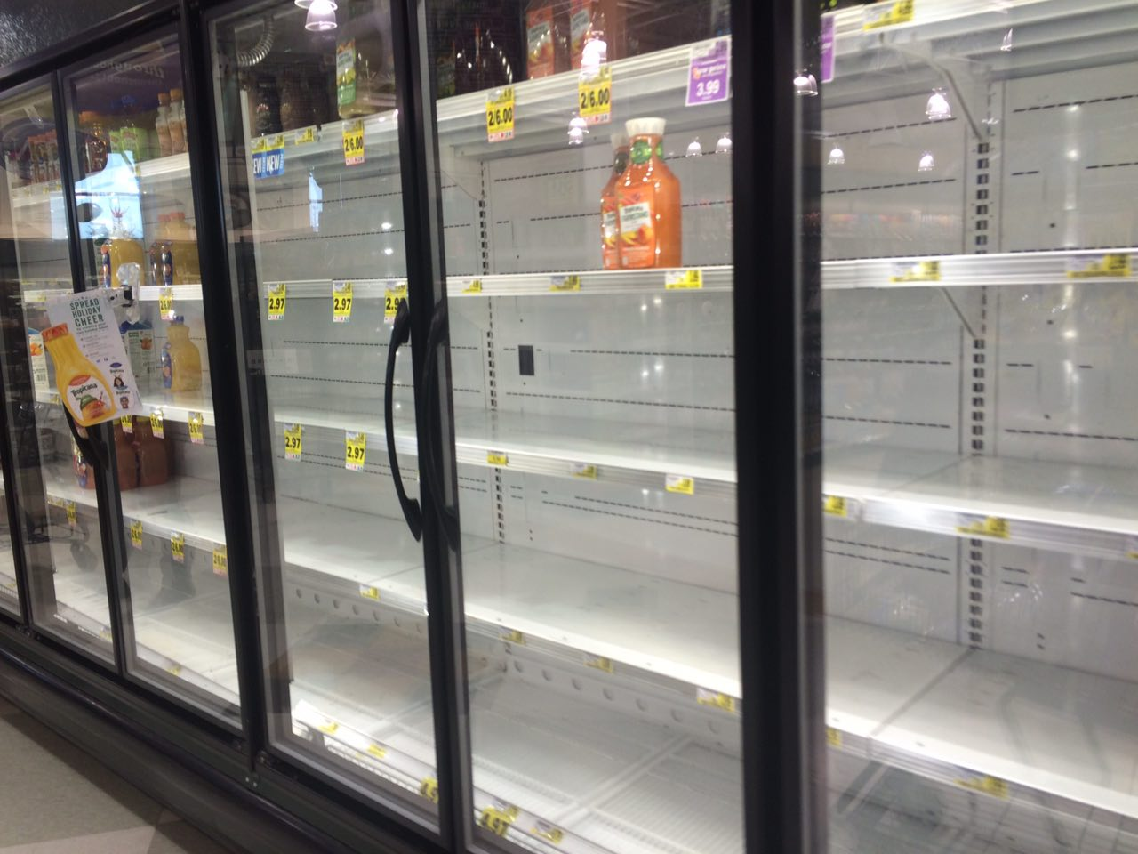
Do you Recognize this?

Slide 3
Mindset
Most have mindset Allah will take care of us
Hadith on Reliance: Trust in Allah, but tie your camel and give regard to worldly causes
Bottom line: You are going to prepare for emergency situations or not.
Notes:
Most have mindset Allah will take care of us but Allah helps those who help themselves. Our job is to protect physically (spiritually by Tarbiyyat ☺. This is due diligence. People will blame us if something happens. We have to protect masjid and people. Our jammat is persecuted as were the earlier people of Islam. World situation is getting worse and worse.
In a perfect, peaceful world, perhaps we would never have to take time out of our busy schedules to talk about security.
But in our very real world, where there are the Fort Hoods and the Virginia Techs, and the other types of events we often hear about unfolding through FOX or CNN, unfortunately, being aware of security (the risks, the challenges, the dangers, etc.) is a must for all of us, whether that’s in our everyday routines or when you’re here with your brothers and sisters taking part in your religious obligations or duties.
But, if for some reason your sitting here today and thinking something like this could never happen here in your majalis, I want you to take a moment to think again. It very well can happen here.
Let me give you some quick facts and figures – the FBI estimates that there are over 200 million privately owned firearms in the US (and this doesn’t include military or police officers). This means that there are roughly more guns out there then the entire US population.
Look, the point is, these are tough times and I want you to be vigilant when it comes to your security. If you look at the state of our country for example where Islam by many unfortunately is understood as a religion that feeds terrorism rather than opposes it, the attitude by some at political rallies (Muslims trying to takeover the country), or the enhanced security procedures at airports where someone could say look what we have to go through because of these Muslims – there are a lot of mixed emotions out there, and some unfortunately have and will continue to take them to the next level (and of course what I mean is translate those emotions into violence).
Bottom line: You are going to have umoomi team as a responsible Qaid or not have it. The question is Are you going to be proactive or reactive. This is not very glorified position but very important.

Slide 4
Words from our beloved Huzoor (aba)
https://www.alislam.org/friday-sermon/2011-11-04.html
As an aside, Hudhur said there is no telling where the financial crisis will lead and how intense it will get. While there is no need panic, Ahmadis should definitely stock few days’ dry food supply at home at all times as a precautionary measure. Hudhur explained that underdeveloped countries are used to such situations and people make some provision or the other but here [in the West] people do not know what such a crisis entails. The last crisis they faced was in WWII and their new generation has no idea of what can come to pass. Hudhur said while taking the precautionary step of stocking some food supply, we should also pray that may God enable the world to recognize their Creator and is saved from chastisement.
Dua – Is the weapon of a believer – Remove stress, worry and anxiety ■
Preparation – Individual Level & Jamaat Level

Slide 5
Awareness and Reaction
Are you on top of current events?
Are you taking the time to be aware of your surroundings?
Do you have presence of mind?
Are you aware of present position of World & problems against Jama’at
Notes:
Are you on top of current events? Do you know what’s going around the world, the country, your communities? Do you know what’s being posted on the internet (Craigslist, facebook, youtube, etc.)? Have you thought about your own personal information you’ve posted
Say you’re at the Mosque, does anything look out of place? Notice a box, suitcase, purse just laying around? Anything suspicious? Do you know where all the exits are (I’m not just talking about where you always come in from)? Do you know all your exit options? How about the fire alarms?
Many of you are regular attendees to your Mosques or Chapters, does anyone seem unfamiliar? Is someone out of place or acting odd? You see anyone going around taking pictures of the property? Is someone coming to the Mosque on a regular bases, but you know he/she is not an Ahmadi? People who are usually planning to do something atrocious or violent are usually acting very odd, very nervous, or very uncomfortable.
These are questions that each and everyone of you need to have answers to. My brothers you must be vigilant during these times…..you must be aware and paying attention to your surroundings.

Slide 6
Scenario
You returned home after school or work and saw in the news that a category I storm is approaching your Majlis in a week? What will you do?
1) Do nothing- You're too tired. Don't feel like doing anything but eating.
2) Talk to your family members about it but you're too sleepy tonight. You'll think about it later
3) Pray about it that may Allah save you, your loved ones and everyone else from the disaster
4) Prepare yourself immediately. Make a list of items needed for food and shelter. Consider a plan for evacuation if necessary. Call your relatives, local qaid sahib, Jamaat members, other khuddam and talk about it. If needed, establish a SAFE HOUSE.

Slide 7
What MKA has done
Sharing of detailed Guidelines with Khuddam
  https://drive.google.com/folderview?id=0BwsGu0gqSKBbQlA3SnlWTXg5SjA&usp=sharing
All Qaideen and Nazmeen Umoomi are requested to use FEMA app for Weather Emergency alerts
Emergency food (MRE)/Food Buckets, water filter kits, first aid kit, water storage (bottles or 55g gallon container) was provided to three majalis from National MKA budget in 2015: CVA, Houston North, Oshkosh

Slide 8
Some examples of Resources
Guidelines from Huzur (aba)
Jama’at Guidelines
How to create local disaster preparedness management plan
Planning for Emergency Evacuations

Slide 9
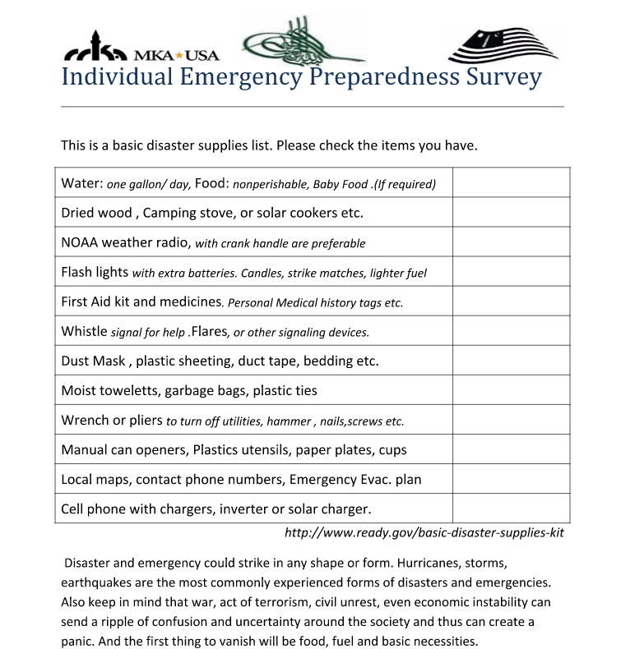

Slide 10
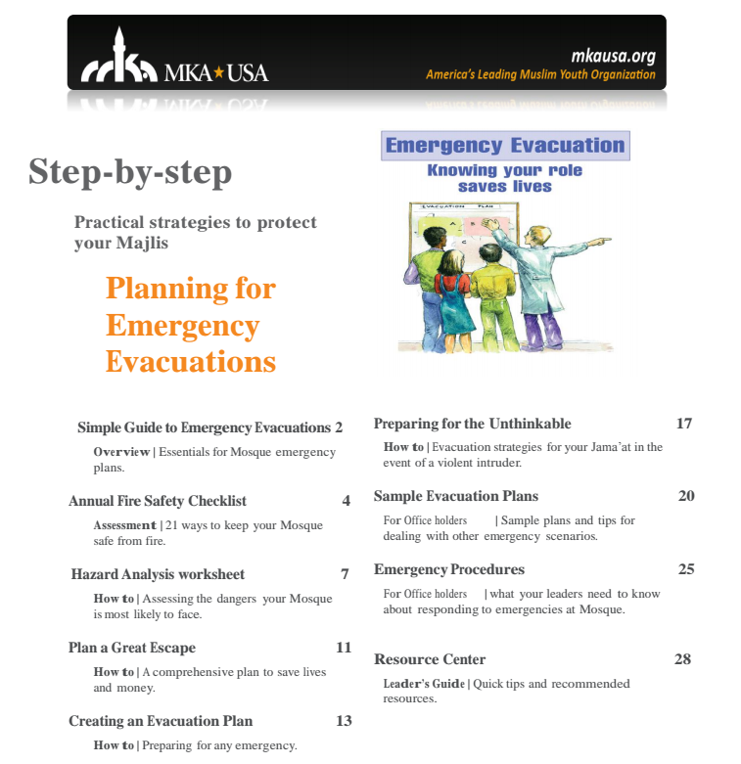

Slide 11
What is happening in 2016
MKA budget is used to send Emergency food bucket and water filtration supplies to Regional Qaideen for demo in their local majalis and promote for individual and jama’at use
Creating a dedicated webpage on MKA USA website (In Progress)
Trainings and Capacity Building at local level
  Coordinating with local CERT teams for FEMA approved disaster preparedness training and other training
  Increasing CPR/AED trained khuddam
Creating Emergency Evacuation Plans (Fire & Active Shooter) for top 10 Large mosques in USA and holding drill

Slide 12
Survival without Food and Water
3 days without water in ideal health and weather conditions – Biggest effect on survival. Water – Adult 1 Gallon/Day – Child .70 Gallon/Day
3 - 8 weeks without food in ideal health and weather conditions (with water)

Slide 13
Emergency Food/Water Options
Open the PDF file to details of various options.
Note: National Jama’at Amoor e Amma has instructed each jama’at t store food and water at mosques for jama’at members. In addition, generator is needed for some backup electricity. Jama’at maintenance budget in low amounts can be used every other amount to build this capability for long term. However, individuals should also store some of these items at low scale for their family at home.

Slide 14
Request for Prayers
Q/A

