Slide 1


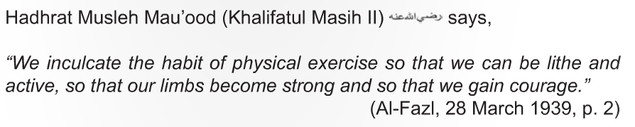
Sehate-e-Jismani
Department Plans 2016-17

Slide 2
Constitution
Nazim Sehat Jismani shall adopt plans concerning general health, and impart important information in this respect to the members of the Jama`at.
The department shall endeavor to introduce different sports and physical exercises among the members of the Jama`at.
Sehat-e-jismani

Slide 3
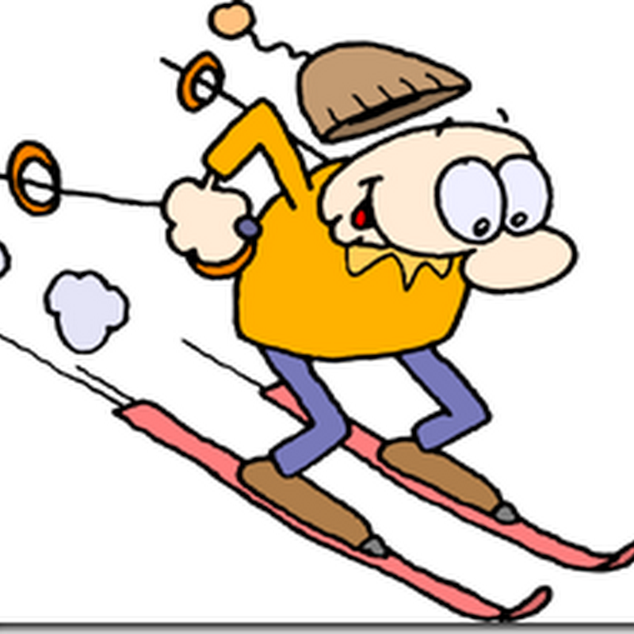

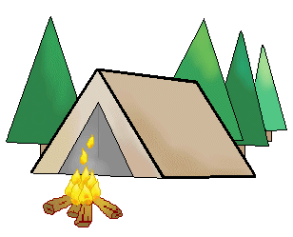
Local Tasks
TASK #1
Organize at least 1 Survival Sport this year.
  Survival Sports include but not limited to: Horseback riding, survival training, archery, shooting, fishing, outdoor skills(camping, fire-building, tent, etc..).
  Work with your Regional Qaid and other local Nazim Sehat-e-jismani’s to plan your event. Contact National SEJ Team for any help needed.
Funding
  Coincides with the Jammat USA - National Amila approved Shura proposal in which local presidents have been given funding to use towards monthly activities in which Ahmadi Youth can come together and foster an environment of brotherhood along with countering the influence of drugs, alcohol, and marijuana use on our youth.

Slide 4


Local Tasks
TASK #2
Organize at least 1 Sporting Event each month
  Create an online survey to determine what type of activities your local or regional Khuddam are interested in.
  Consistently plan, organize and lead a recreational event for your local Majalis’.

Slide 5

TASK #3
Organize at least 1 “Pray Healthy” event each month in which the local Sehat-e-jismani will be tasked to complete one of the following options:
    Serve or prepare Healthy Snacks or Meals after Salat
    Give a presentation on Health &/or Islamic Hygiene. (National SEJ Dept. can provide resources to use or feel free to research and share on your own)
    Organize a Fajr Fit Event

Slide 6


Local Tasks cont’d…
Task #4
Follow National SEJ Department on Twitter for news, updates, and events @MKA_fit - https://twitter.com/MKA_fit
Task #5
Join the Local Sehat-e-jismani Telegram Group

Slide 7



KEY DATES
Event | Date
MIST SOCCER, VOLLEYBALL & STRONGMAN | April 15 – 16
Nasir T20 Tournament (Cricket) | September 2 – 3, 2017
CANADA – Nasir Sports Tournament (basketball, soccer, table tennis and badminton) | March 2017 (TBA)
CANADA – Cricket Tournament | August 2016
MIST BASKETBALL | October or November 2017

Slide 8
Resources
Steps to Exercise – Book by Hazrat Mirza Tahir Ahmad (Khalifatul Masih IV) - LINK
Contact the SEJ National Team:
  Usman Jamil – usman.jamil@mkausa.org 301-938-4364
  Rahman Nasir – Rahman.nasir@mkausa.org
  Bilal Raja – bilal.raja@mkausa.org
  Usman Sheikh – (Willingboro)
  Yusuf Dosu – (Laurel)
Sehate-e-jismani

Slide 9
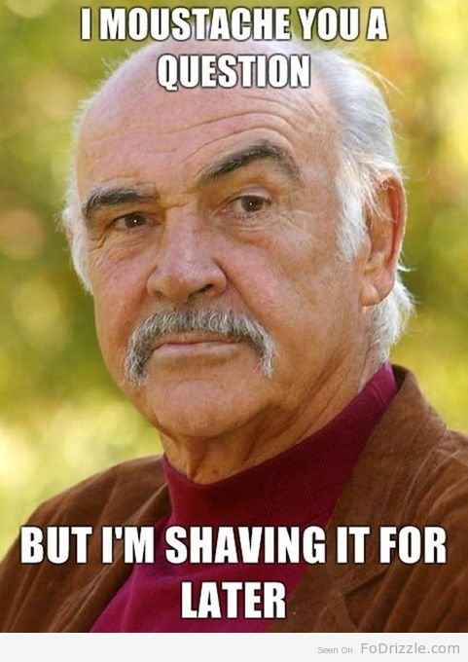
QUESTIONS?
Sehate-e-jismani
  THE END

