Slide 1
Sehat e Jismani
Health & Fitness MKA USA

Slide 2
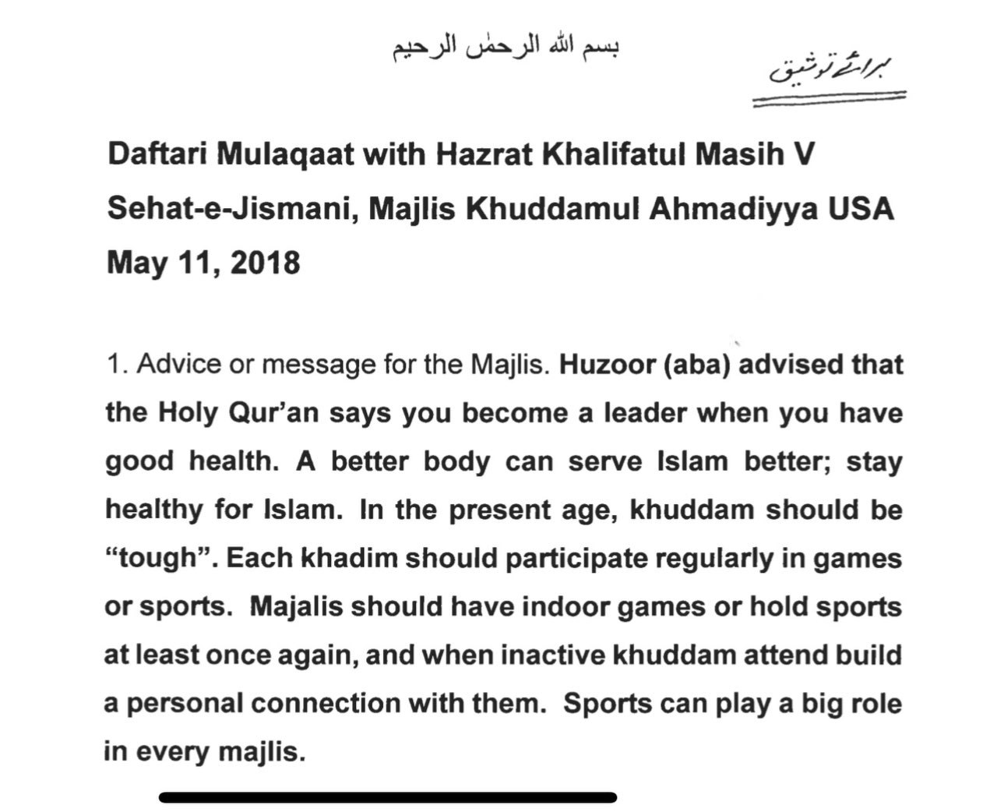
Message from Huzoor:

Slide 3
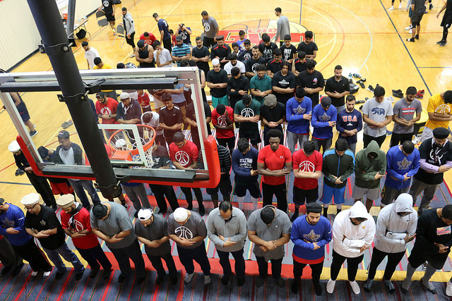
Pray & Play
“THE ULTIMATE GOAL IS TO BRING KHUDDAM CLOSE TO THE JAMAAT AND STAY AWAY FROM HARMFUL ‘FAZOOL’ ACTIVITIES” ~ Huzur (aba)

Slide 4
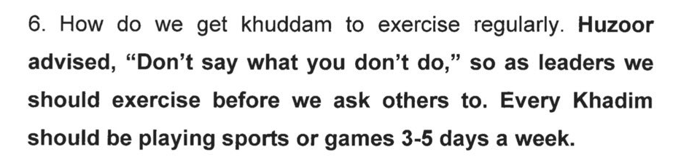
Personal Health
SeJ Health tip of the month
Quarterly video

Slide 5
Key Dates
Key Dates
Nov 1st, 18 | Start of MKA Year
Q1, 19 | Regional Sports Days
April, 19 | MIST Soccer/flag football/volleyball/badminton
Spring/ Summer, 19 | Ahmadiyya Basketball Camps
Summer, 19 | MKA National Hike
Fall, 19 | Nasir T20 cricket tournament
Fall, 19 | MIST Basketball

Slide 6

MIST
2 Events Including Basketball, Soccer, Flag football, Volleyball, Strongman, and Badminton
Expected dates: Spring 2019 and Fall 2019
Attendance in 2018: 350
Qaideen and Regional Qaideen should Encourage their Majalis to attend

