Slide 1

MKA USA
Social Media
Best Practices

Slide 2
Reminders
Post in line with MKA standards and guidelines.
Do not respond to trolls or engage in unnecessary banter.
Make sure you present yourself in a respectable manner.

Slide 3
Posting Material
Only post relevant material that is associated with your local MKA chapter.
Due to global audience, refrain from using humor as things can always be misinterpreted.

Slide 4
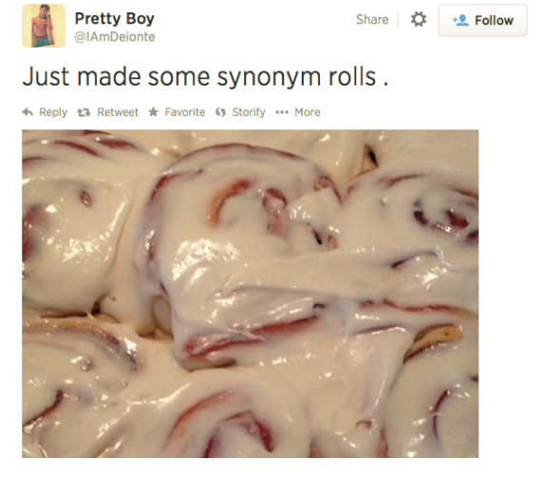
Posting Material

Slide 5
Not sure if it should be sent?
If there is a hot button topic trending, seek guidance before posting about it.
Choose quality over quantity.
Never discuss other people's private lives without their permission.
If you are an officer in the majlis or Jamaat, think twice before every post. If there's any doubt, just don't tweet it.

Slide 6
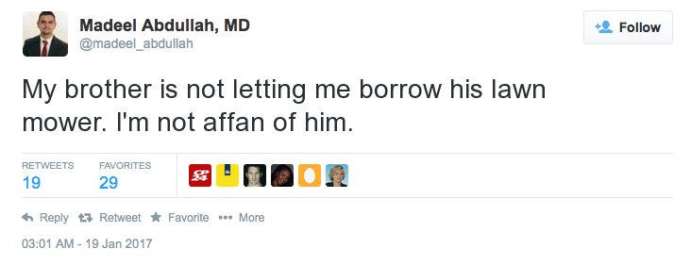
Refrain from using social media to vent frustrations.

Slide 7
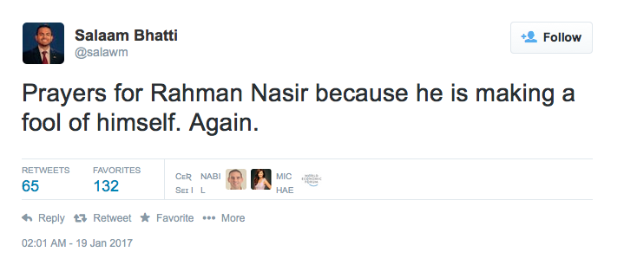
Communicate positively, not negatively.

Slide 8
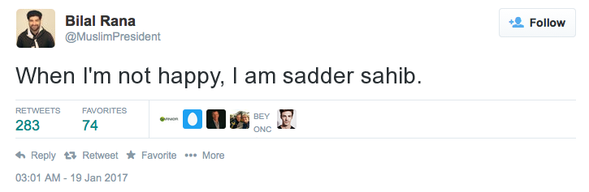
Stay away from jokes.

Slide 9
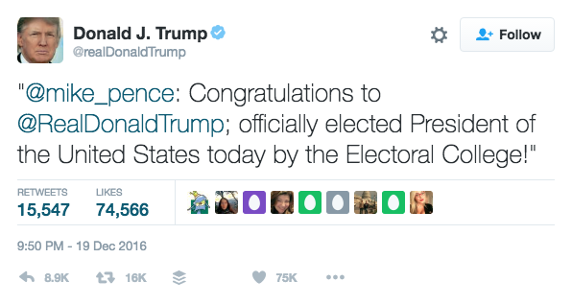
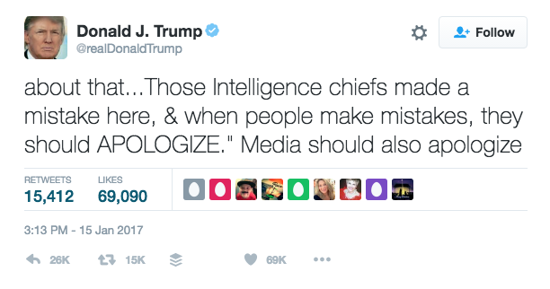
If you didn’t pay attention to any of this presentation, here’s one takeaway:
Don’t tweet like him.

Slide 10
Resources
Contact the MKA USA Social Media team
socialmedia@mkausa.org
Disclaimer: Madeel, Salaam, and Sadr Sahib tweets were fake.

