Slide 1


Tabligh
Departmental Plan

Slide 2

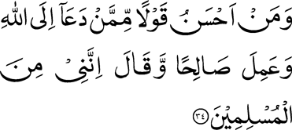
And who is better in speech than he who invites men to Allah and does good works and says, ‘I am surely of those who submit?’ (41:36)

Slide 3

"Whoever guides (another) to a good deed will get a reward similar to the one who performs it."
(Sahih Muslim)

Slide 4
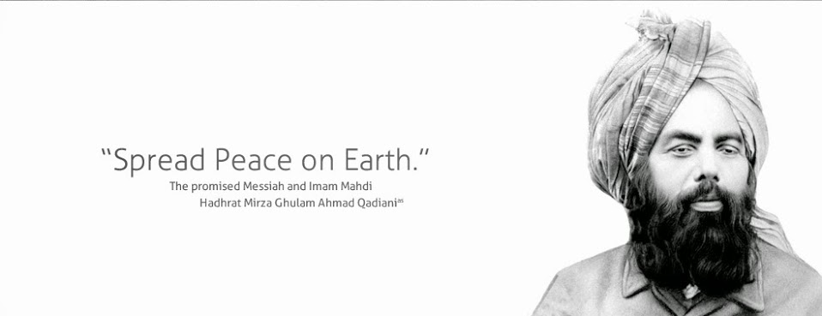
“God Almighty desires to draw all those who live in various habitations of the world, be it Europe or Asia, and who have virtuous nature, to the Unity of God and unite His servants under one Faith. This indeed is the purpose of God for which I have been sent to the world. You too, therefore should pursue this end but with kindness, moral probity and fervent prayers” (Al-Wassiyat)

Slide 5
overview
TABLIGH TABLES
EMPOWERMENT
ADOPTION
TOWN HALL

Slide 6
1. Tabligh Tables
Continuing to put the “Tabl” back into Tabligh
Organize Tabligh Tables in public spaces:
Markets
College campuses
Libraries
in order to create face to face contact with the public and engage in dialogue.

Slide 7
2. Town Hall
“Meet an Imam”
“Meet a Muslim”
Setup a meeting:
community centers and town halls
In rural areas where a young Imam or 2-3 well trained individuals would answer and entertain questions from local community members.
Have an honest conversation about hard-hitting topics that are challenging and dispel the rumors and myths pertaining to Islam

Slide 8
3. Empowerment
Tabligh Empowerment:
Quarterly Web Meeting (Ring Central) meeting with live training sessions with Nazimeen
A dedicated page on MKA USA website for resources and tools for tabligh. (FAQ’s, How to Guides, Manuals, Feedback, etc)
Hard Copy of a Manual for each Jama’at which would contain pertinent information on how to approach contacts, objectives, process to be an affective Da’een.
Multimedia (DVD’s of Hadur’s Q&A, Intro to Islam-Ahmadiyyat Videos, Prepared Power Point Presentations

Slide 9
4. Adoption
Adopt-a-Prof:
Encourage students in institutions of higher learning to develop a personal relationship with professors.
Establish a dialogue with audiences of higher learning regarding contemporary issues of the Islamic world and promoting social awareness of Islam and Ahmadiyyat.
Arrange guest lecturers to address the classes on various issues concerning Islam.
Continued communication via letters, e-mails, telephone and follow-up to notify them about future events.

Slide 10
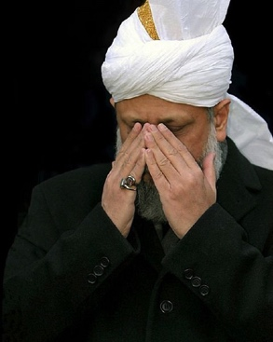
One Last Thing

