Slide 1

Tabligh تبلیغ
Department Plans 2016-17

Slide 2
Constitution
“Muhtamim Tabligh shall arrange to engage Khuddam in Tabligh”
Tabligh

Slide 3
National Plan
Plan outline for the Majaalis:
A town has been selected for every majlis where the Tabligh efforts will be concentrated.
Hold 2 “Meet a Muslim” sessions on the streets every month. (Preferred if these sessions are also broadcasted on Periscope)
Hold 1 Holy Qur’an Exhibition every quarter in the town assigned.
  God of Islam & Holy Qur’an
  Prophet Muhammad (sa)
  Jesus Son of Mary (as)
  The Promised Messiah (as)
Give out flyers prior to each Holy Qur’an Exhibition.
Participate in the National Tabligh Day

Slide 4
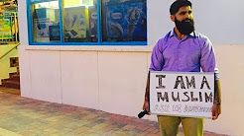
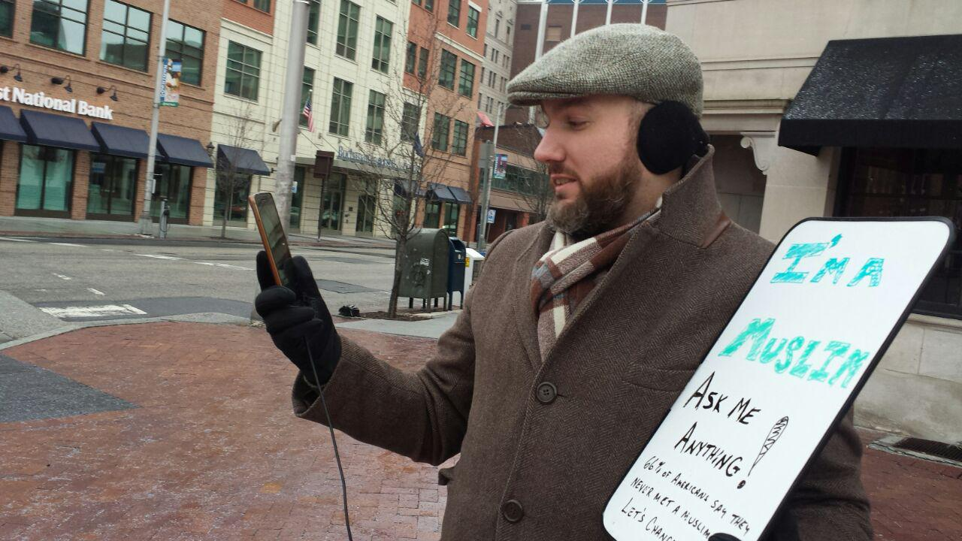
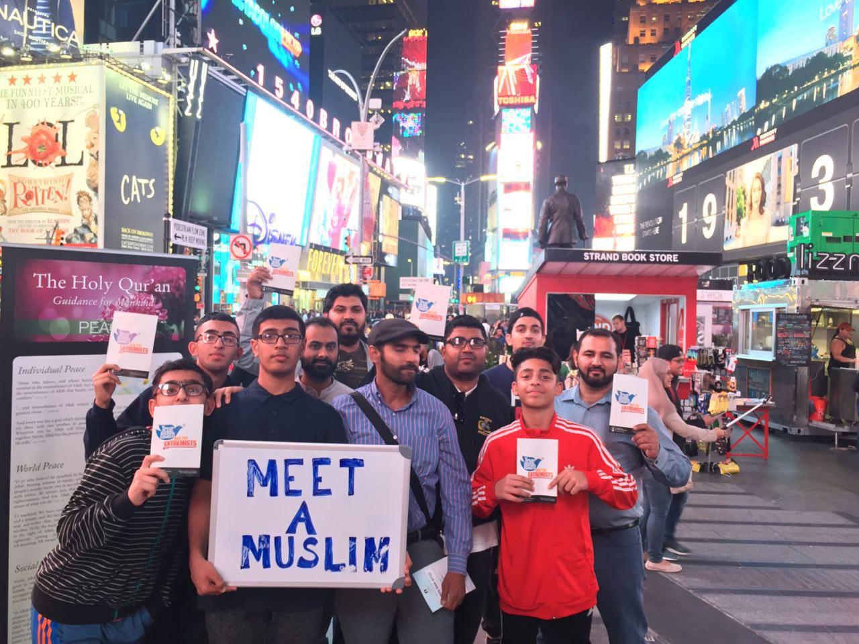
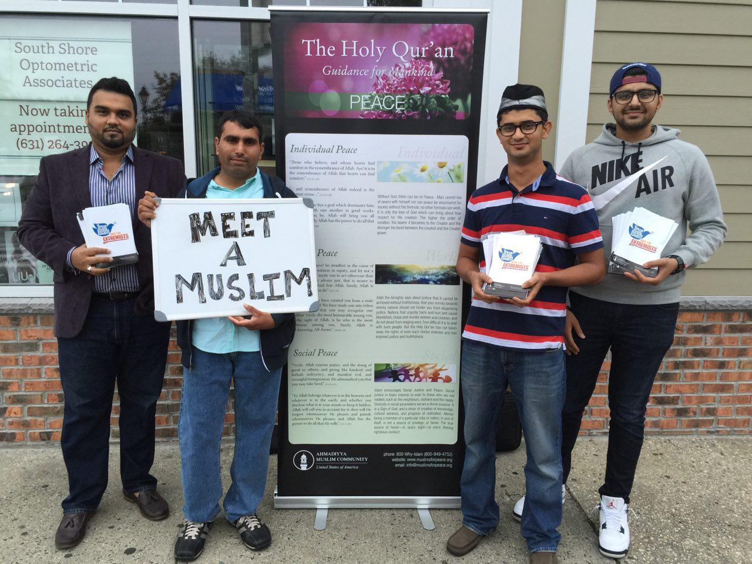
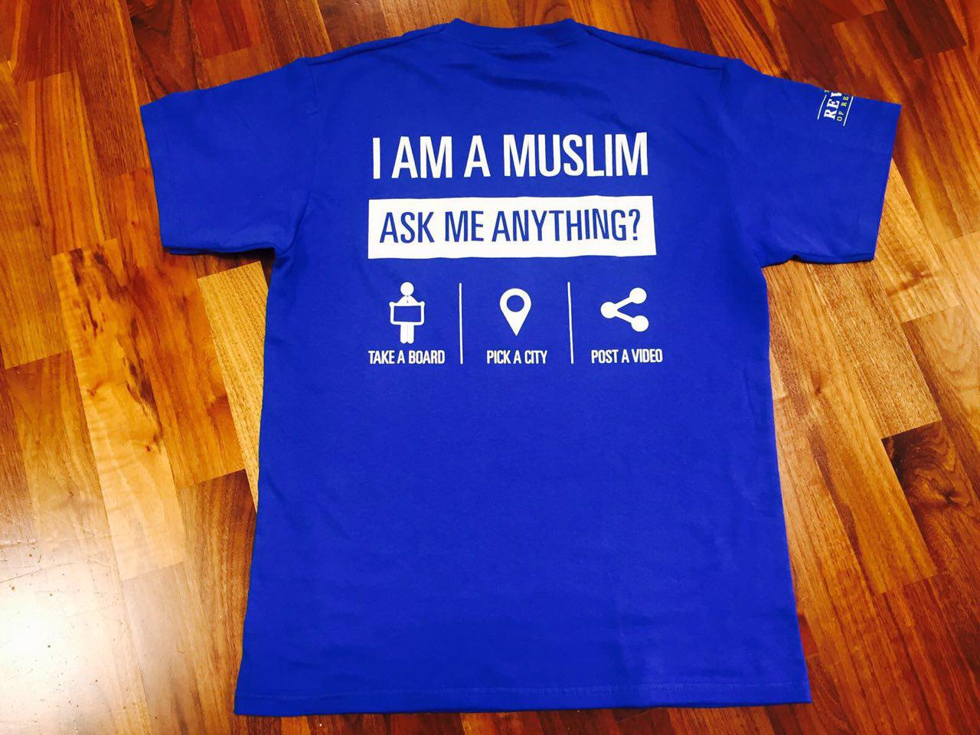
2016-2017 Goals
MEET A MUSLIM: 24 “Meet a Muslim” sessions broadcasted live via Periscope by each Majlis Insha’Allah.
Tabligh

Slide 5
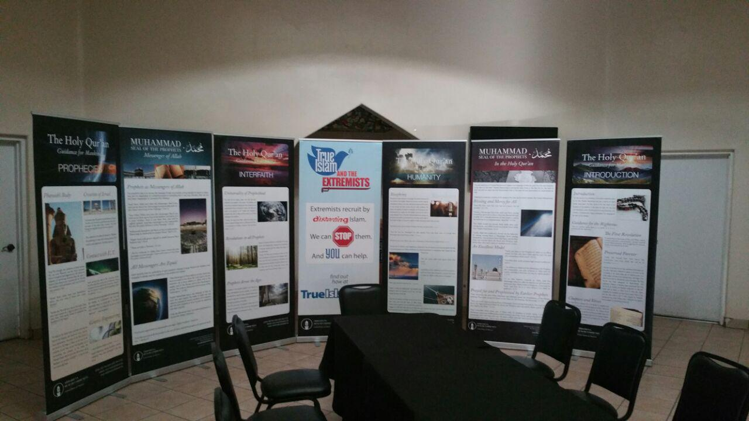
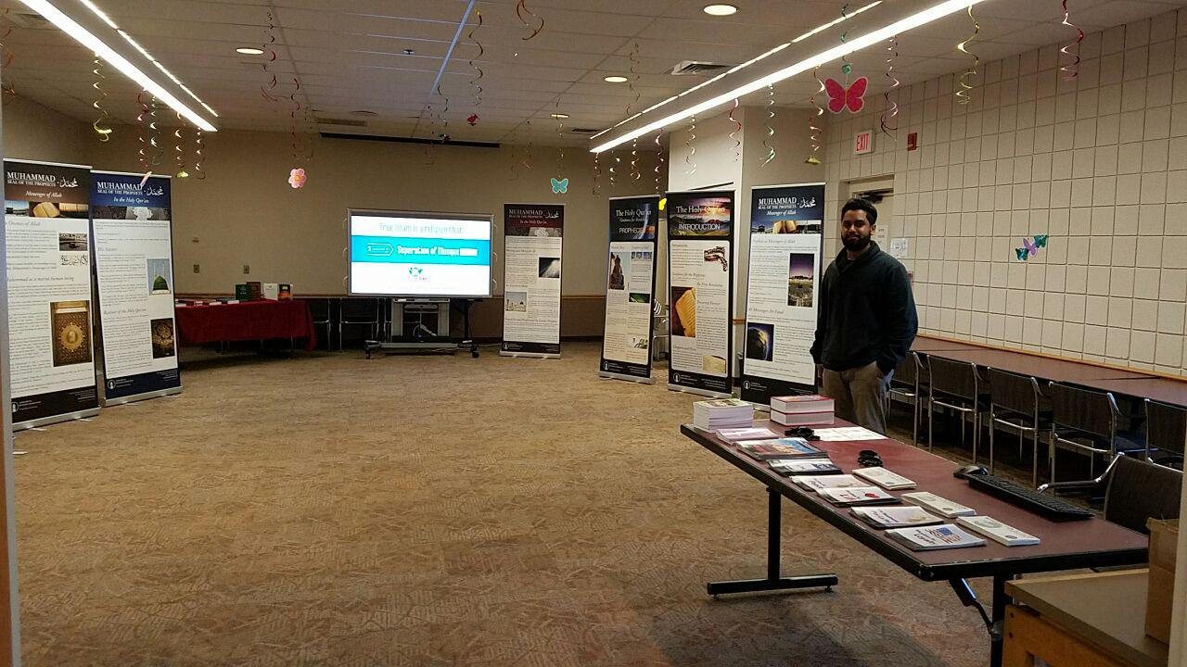
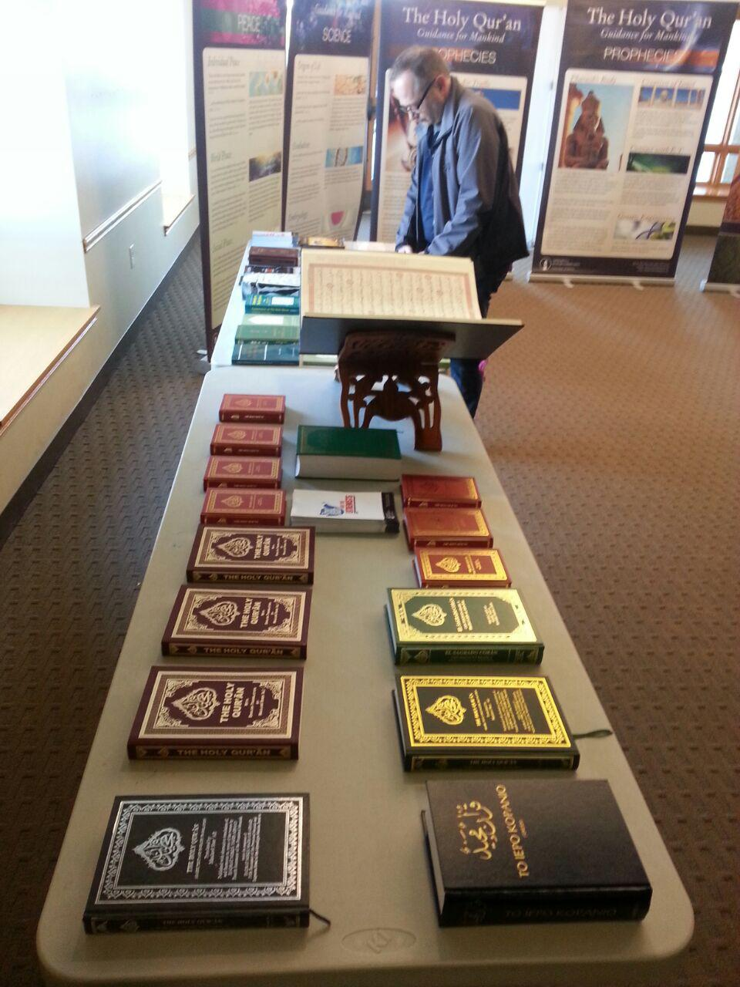
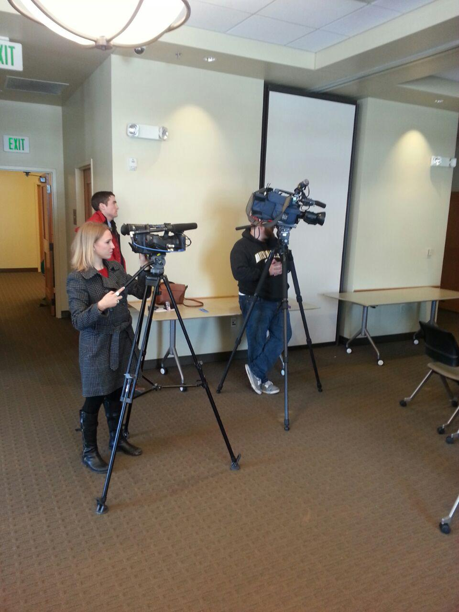
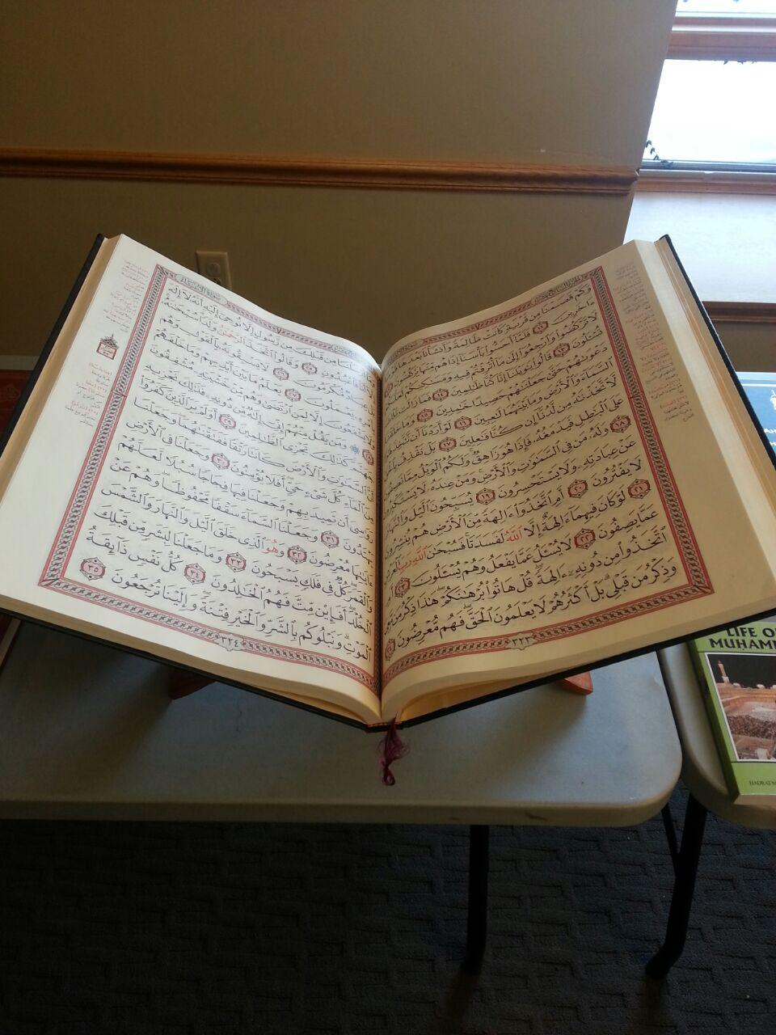
2016-2017 Goals
HOLY QUR’AN EXHIBITION: 4 “HQE” per majlis. Preferably One for each Quarter Insha’Allah.
  First Exhibition: God of Islam & Holy Qur’an
  Second Exhibition: Holy Prophet Muhammad (sa)
  Third Exhibition: Jesus (as) in Islam
  Fourth Exhibition: The Promised Messiah (as)
Tabligh

Slide 6
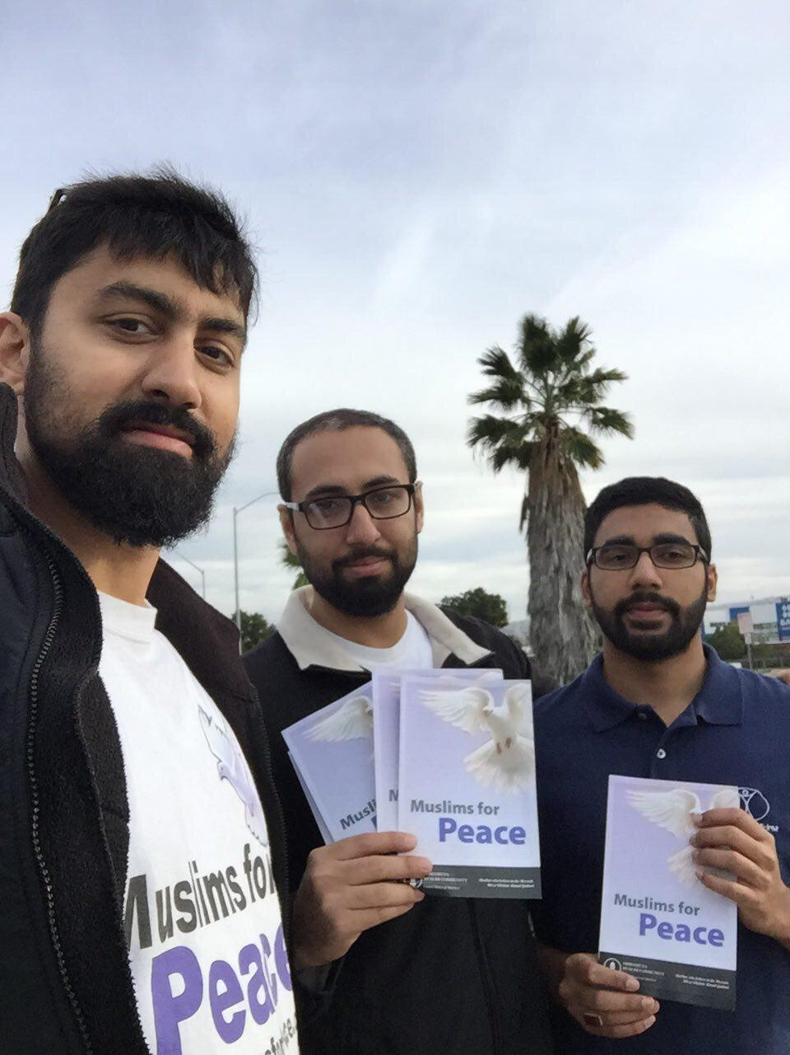
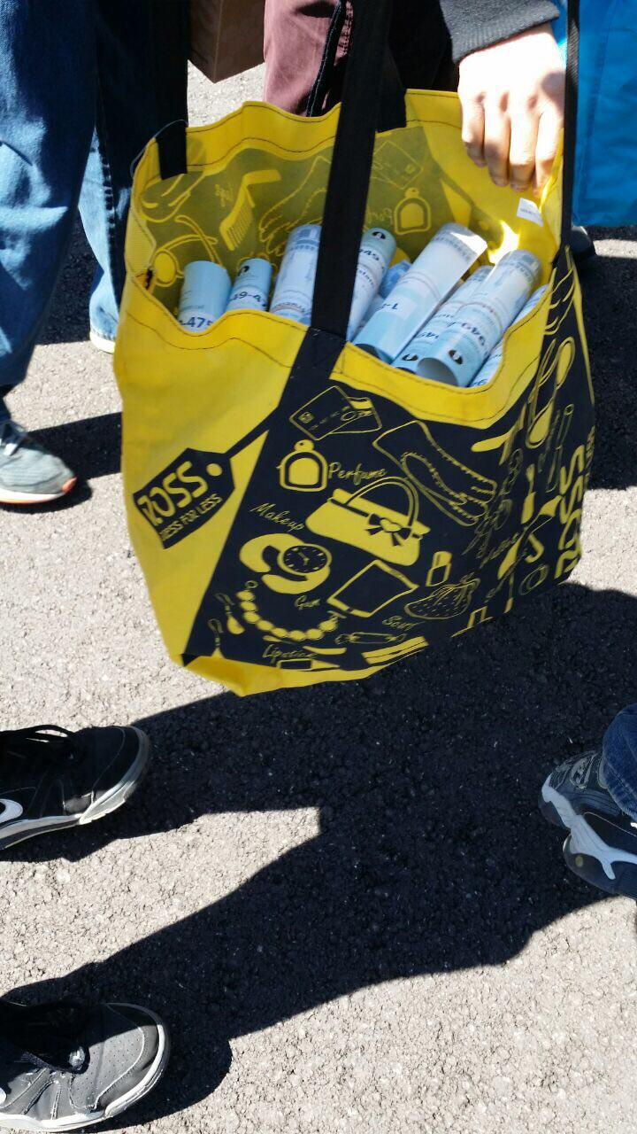
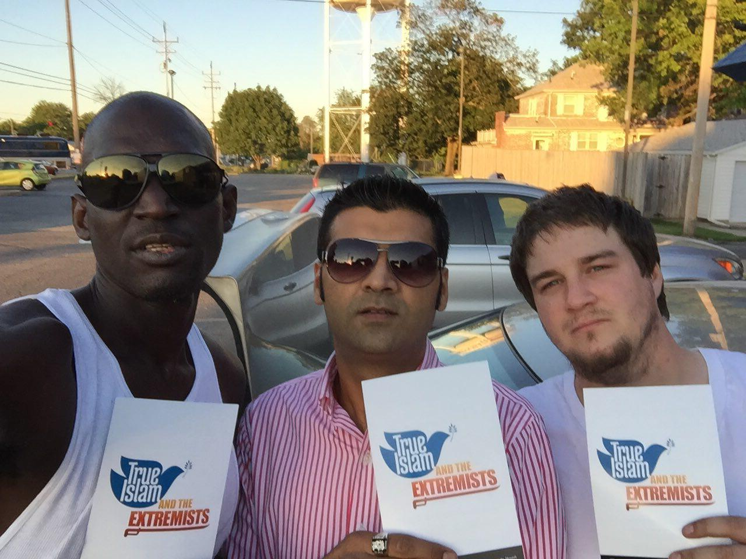
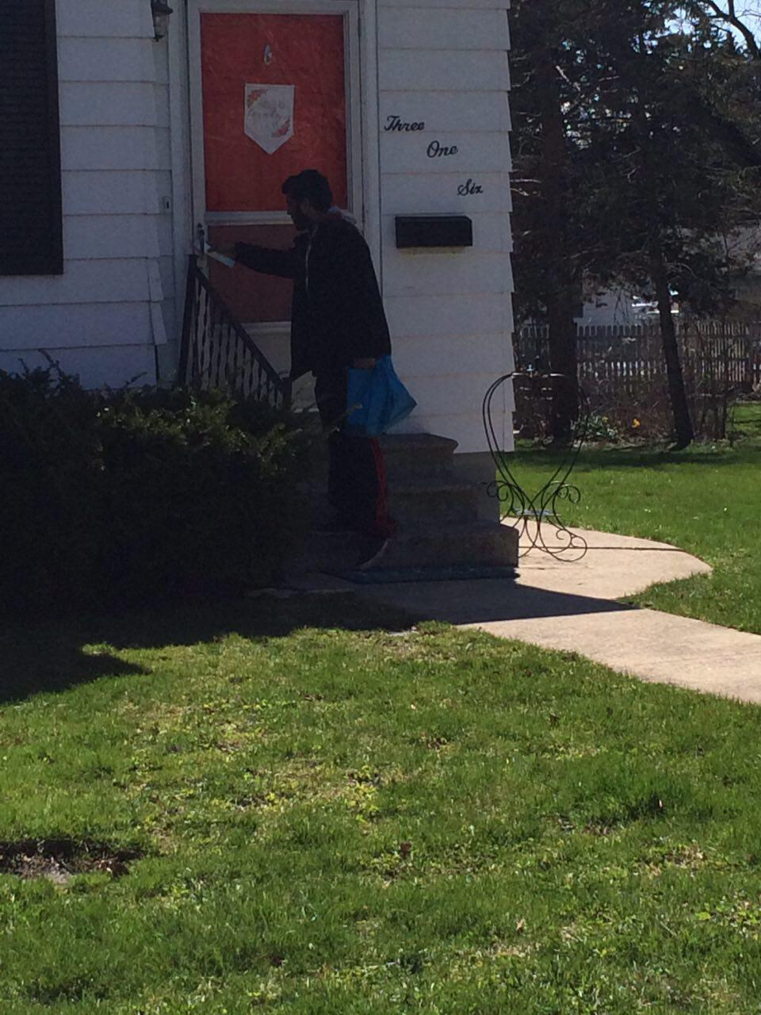
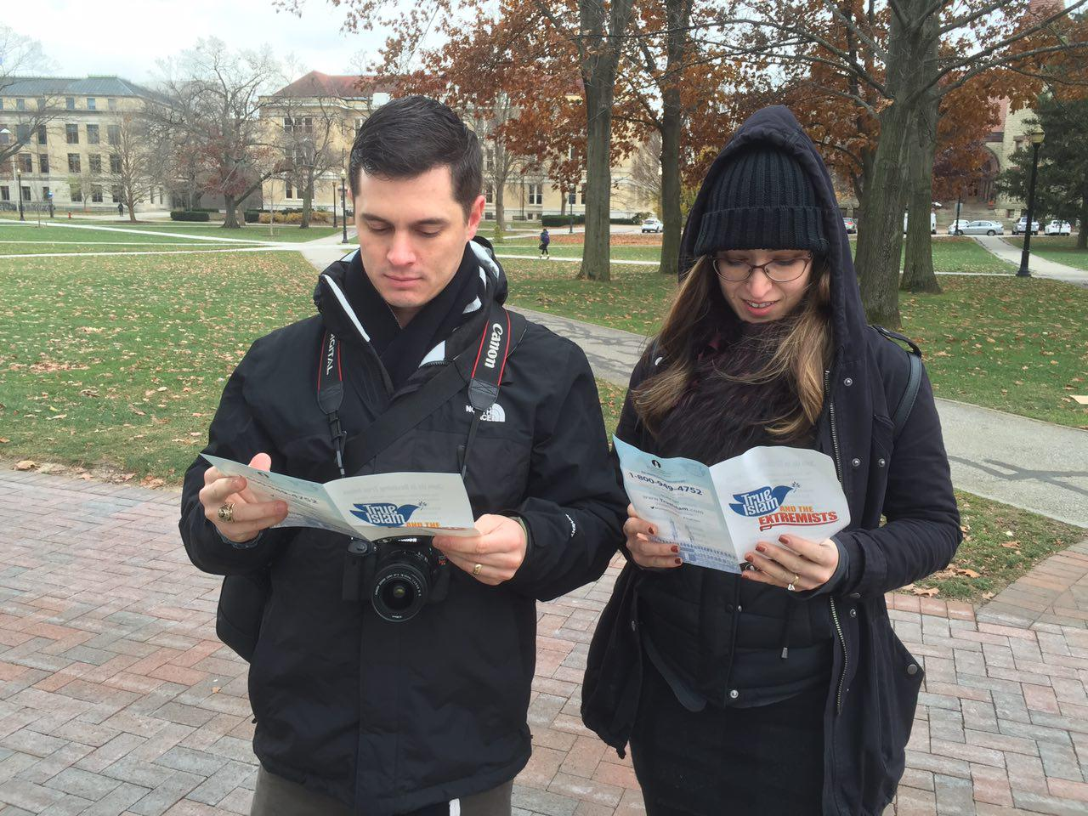
2016-2017 Goals
Flyers Distribution: Collectively we all distribute Half Million Flyers nationwide (Insha’Allah)
Tabligh

Slide 7
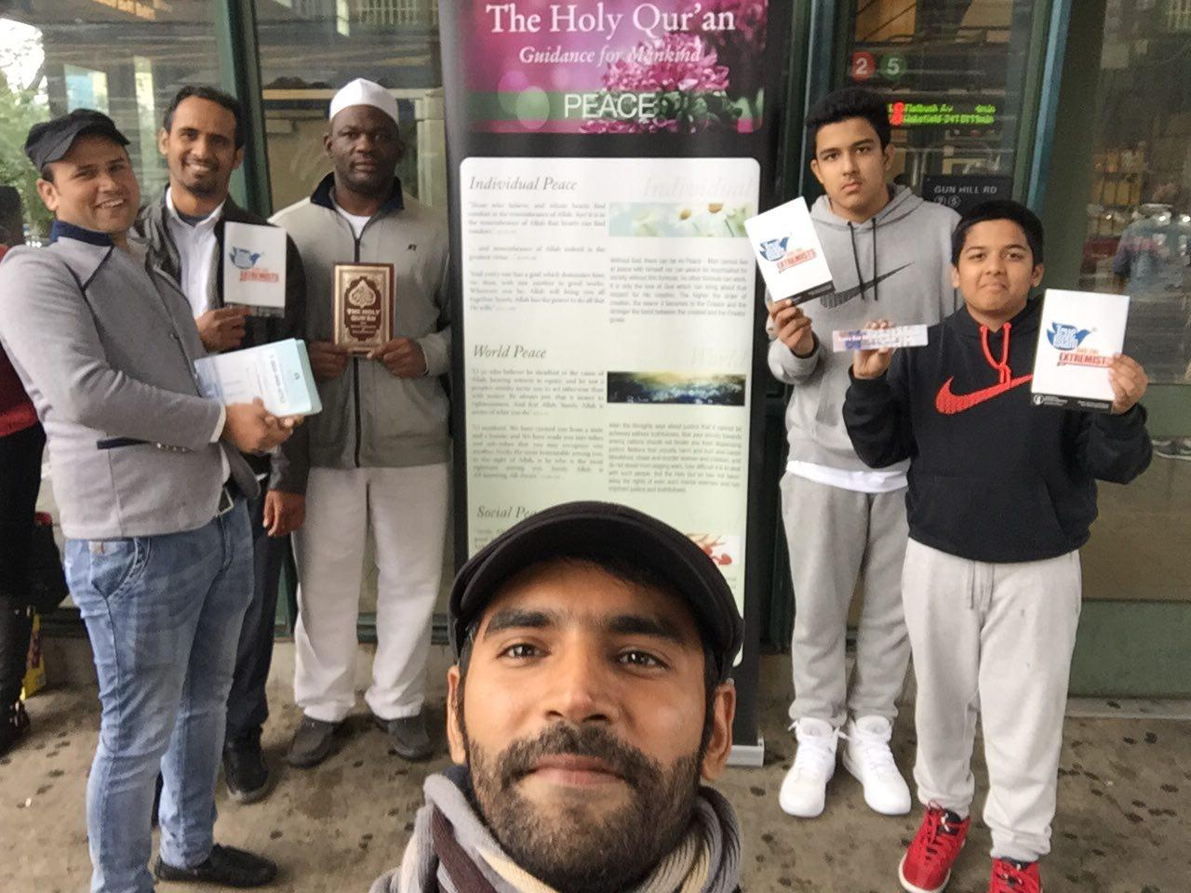
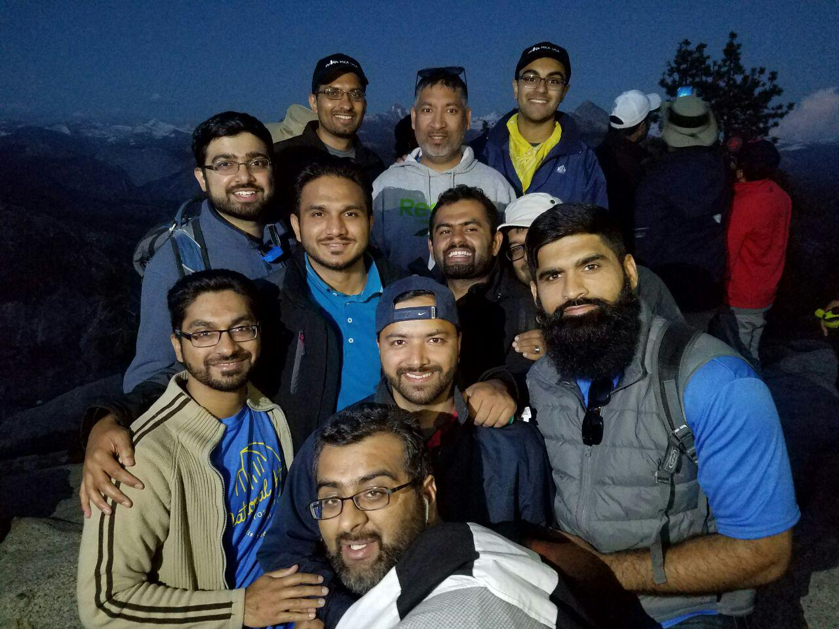
2016-2017 Goals
NATIONAL TABLIGH DAY: Participate in the national MKA Tabligh Day. Date to be announced Insha’Allah.
Tabligh

Slide 8
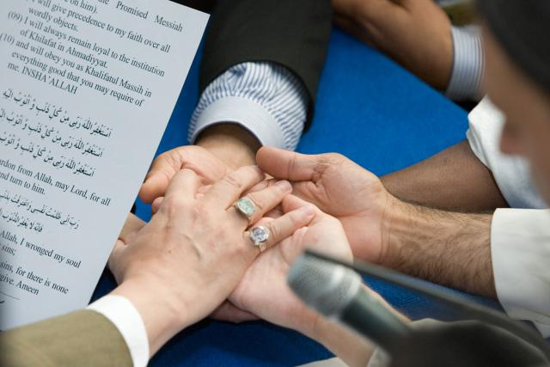
Bai’ats
Insha’Allah we will try to bring 75 Pious Souls into the fold of Islam Ahmadiyyat in USA this year.

Slide 9
Maal National Team
Title | Name | Email | Phone
Mohtamim Tabligh | Faran Rabbani | Tabligh@mkausa.org | 202 322 9014
Naib Mohtamim Tabligh 1 | Tariq H. Malik | Tariq.Malik@mkausa.org | 202 509 6769
Naib Mohtamim Tabligh 2 | Dr. Iftekhar Ahmad | Iftekhar.Ahmad@mkausa.org | 248 875 4389
Naib Mohtamim Tabligh 3 | Waqas Bin Khalid | Waqas.Khalid@mkausa.org | 218 428 1155
Naib Mohtamim Tabligh 4 | Hanan Shahid | Hanan.Shahid@mkausa.org | 618 554 6597
618 554 6597
618 554 6597
618 554 6597
Tabligh

Slide 10
