Slide 1
Tabligh تبلیغ
Department Plans 2018-19

Slide 2
Constitution
“Muhtamim Tabligh shall arrange to engage Khuddam in Tabligh”
Tabligh

Slide 3

National Plan
Department goals:
A town has been selected for every majlis where the Tabligh efforts will be concentrated.
Create and educate 100 Da’een nationwide - 5-day da’een training camp
100 ‘Ask an Imam’ in-person events led by a khadim Imam
100 ‘Ask an Imam’ online sessions on Periscope and Facebook Live
Hold 300 face-to-face tabligh events nationwide – flyer distribution, I am a Muslim Ask me Anything, tabligh stalls, and Holy Quran exhibitions
200 ‘Meet A Muslim’ (MAM) events (prisons, places of worship, police/fire department)
Make 250 new tabligh contacts in the year
Online tabligh - weekly social media posts and interactions by da’een
50 da’een to each develop 1000+ followers on Twitter.

Slide 4
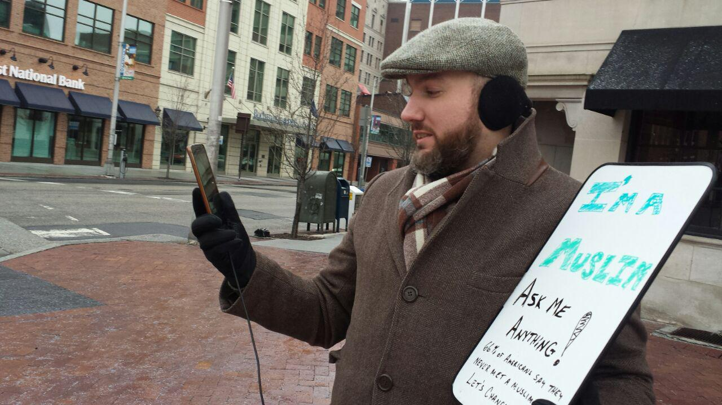
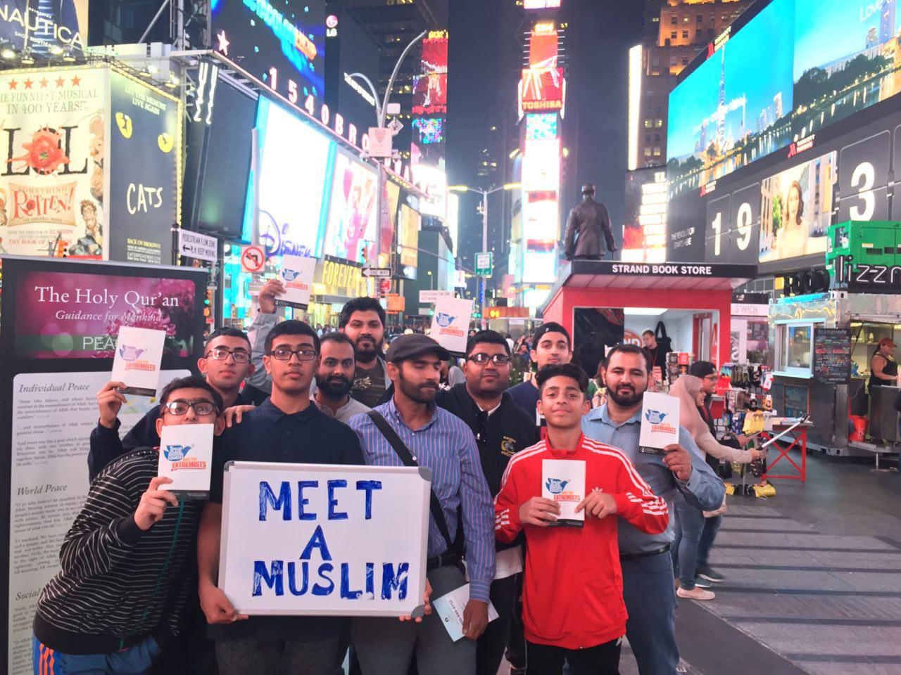
2018-2019 Goals
Tabligh

Slide 5
Local Implementation - bi-annually
Goal | Small | Medium | Large
Tabligh - 1 Major city | 2 | 3 | 3
Tabligh - 1 small town | 2 | 3 | 3
MAM | 2 | 2 | 3
Tabligh

Slide 6
National Tabligh Team
Title | Name | Email | Phone
Mohtamim Tabligh | Abdullah Dibba | Tabligh@mkausa.org | 410 349 7364
Naib Mohtamim Tabligh 1 | Qasim Rashid | Qasim.Rashid@gmail.com | 630 709 8040
Naib Mohtamim Tabligh 2 | Wajahat Ali | wajahat.md.ali@gmail.com | 414 336 4189
Naib Mohtamim Tabligh 3 | Zahir Mannan | Mannanzahir@gmail.com | 860 670 6402
Naib Mohtamim Tabligh 4 | Maaz Bajwa | Maazatb@gmail.com | 858 666 7117
Tabligh

Slide 7
TEAM MEMBERS
Sohaib Awan - Supervising Naib Sadr
Imam Mahmood Kauser
Imam Tariq Naseem
Faiq Malik
Nouman Ahmad
Taimur Khan
Badar Malik
Abrahim Rehman
Zubair Abaidullah

