Slide 1
Umur-e-Tulaba
Department Plans 2018-2019

Slide 2
Constitutional Requirements
Muhtamim Umoor-e-Tulaba shall keep an up to date record of all the Khuddam students in the Majlis.
Muhtamim Umoor-e-Tulaba shall supervise all affairs of the Khuddam students in the Majlis.

Slide 3
2018-2019 Goals
Build and maintain a database of all Khuddam students in the Majlis. Update this database periodically to reflect current academic pursuits of all students and provide tailored guidance.
Activate, Establish, and Maintain 25 AMSAs.
Hold 50 on campus Tabligh events. Focusing primarily on the Meet a Muslim Event.
Provide guidance through the Graduate School consulting committee for all matters dealing with said subject.
Identify particularly gifted students and cultivate an environment of academic achievement. (per shura proposal)
Hold 5 Refugee and New Immigrant focused college awareness programs.
Hold Atfal aimed college awareness programs at Atfal Rallies.
Provide general application consulting and essay editing

Slide 4
Student Tajneed Database
2 Step Effort
Step 1: Provide local Tajneed list to all Nazimeen to denote each individual a Student or Non-Student.
Step 2: Have each student fill out the Tajneed survey collecting all relevant academic information. Qaideen and Nazimeen are responsible for ensuring each individual denoted a student completes the form.

Slide 5
AMSA
8 Active:
University of Texas at Austin (Austin)
The Ohio State University (Columbus
George Mason University (Central Virginia)
University of Mary Washington (Southern Virginia)
Wayne State University (Detroit)
University of Illinois Urbana-Champaign (Chicago)
University of Texas at Arlington (Fort Worth)
Texas A&M University (Houston Cypress
10 in the process of registering:
University of Maryland- College Park (Silver Spring)
University of Maryland- Baltimore County (Baltimore)
University of Pittsburgh (Pittsburgh)
University of Texas- Dallas (Dallas)
Virginia Commonwealth University (Richmond)
Baruch College (Queens)
Northern Virginia Community College (Southern Virginia)
Temple University (Philadelphia)
University of Houston (Houston North)
Need: Local Outreach to schools with 3+ Khuddam Present

Slide 6
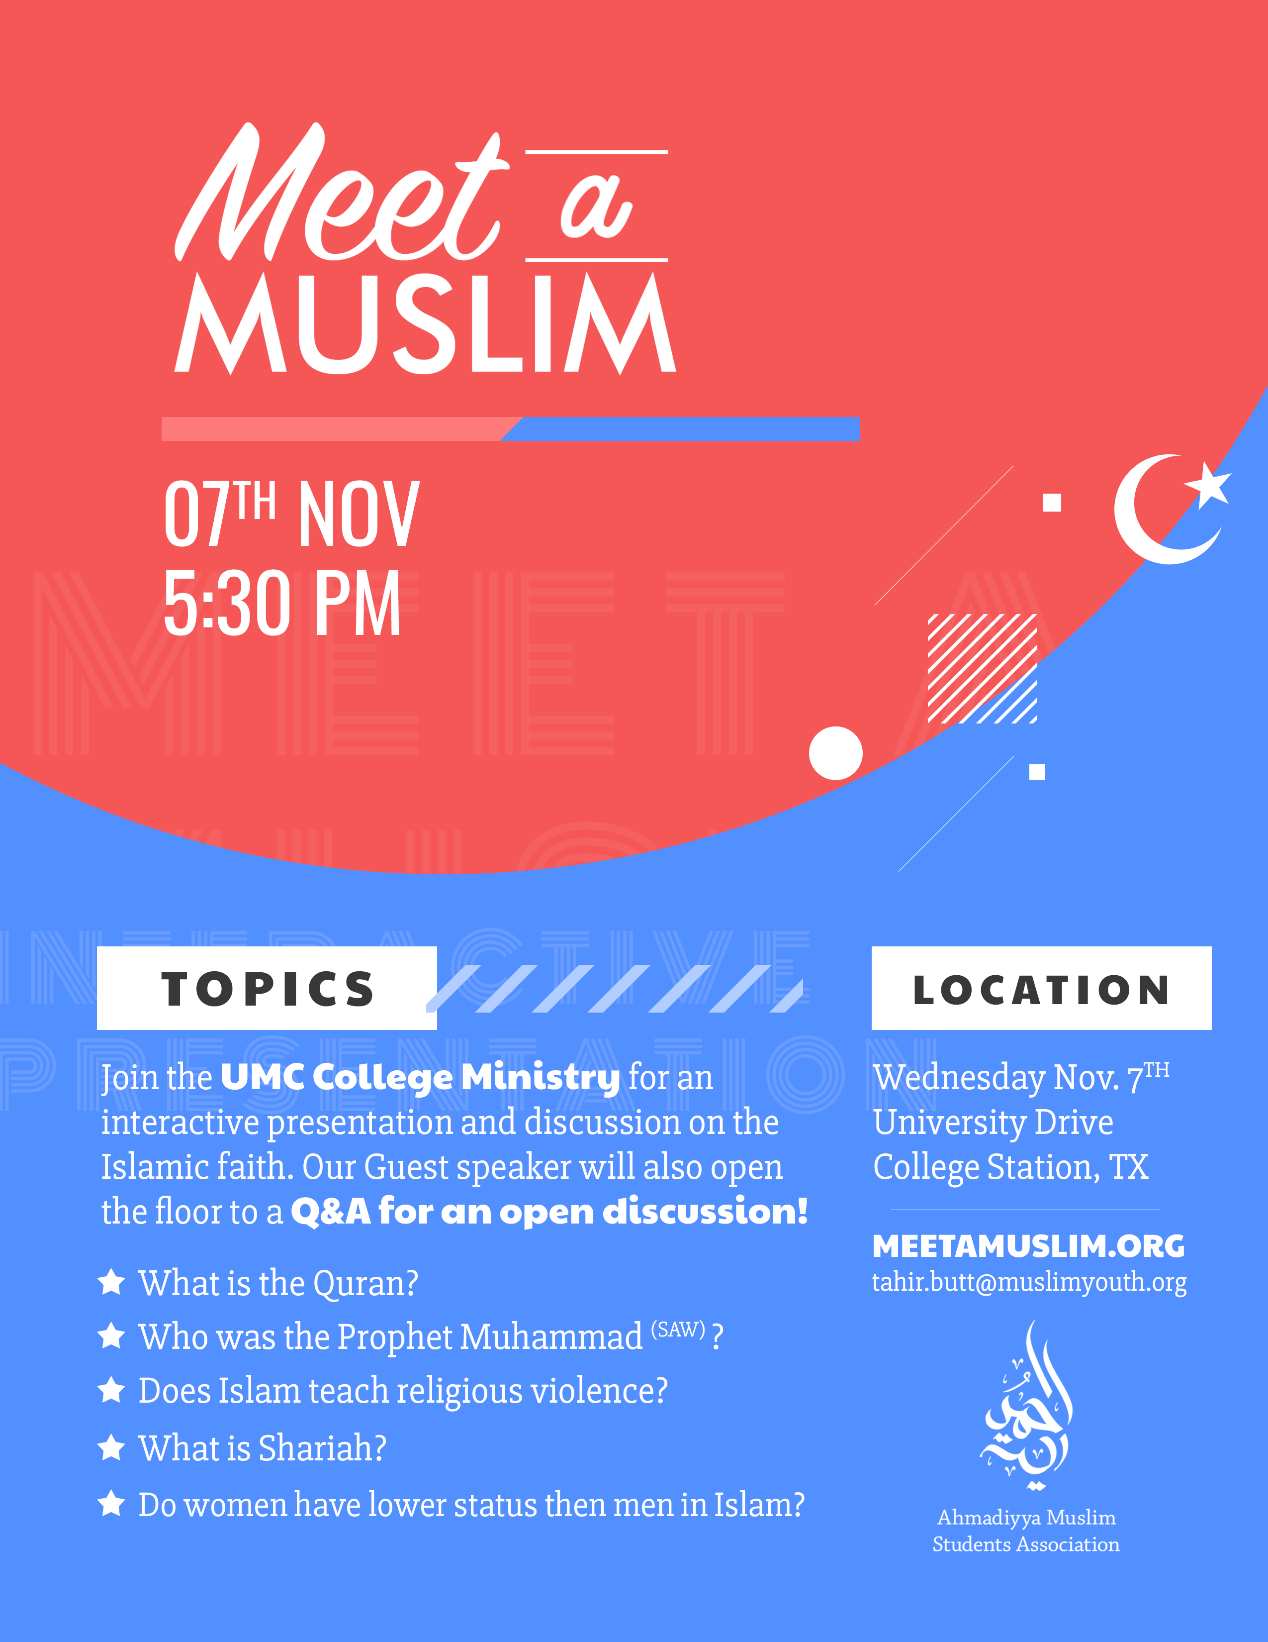

Slide 7
Meet the National Team
Mohtamim:
Ahtesham Najeeb Chaudhry (Silver Spring)
Naib Mohtamimeen:
Murad Bhatti (Silver Spring)- Administration
Tahir Butt (Cleveland)- Tabligh Events/Meet a Muslim
Adeel Malik (Potomac)- AMSA
Zaryab Gondal (Southern Virginia)- Refugees/Immigrants
Ufund Khan (Silver Spring)- Design
Muavin Mohtamimeen:
Sinaan Younus (Baltimore)- Undergraduate Application
Adeel Ahmad (Harrisburg)- Graduate Application
Mohammad Khan (Baltimore)- Meet a Muslim
Hassan Syed (Columbus)- AMSA

